Slide 1
EVENTOS
2019
XVII Jornadas CRAI
Canvas, the user case at the university of Amsterdam
By: Nynke Kruiderink, University of Amsterdam

Slide 2
Who am I at the faculty of Social and Behavioural Sciences, UvA
  Projectleader Implementation Canvas
  &
  Teaching and Learning Coordinator
Purpose of this presentation
  Implementation of Canvas at the University of Amsterdam

Slide 3
Timeline implementation of Canvas
2015-2016
Future Electronic Learning Environment Committee
2016-2017
UvA choose LMS-Canvas
2017-2018
Implementation (Jan '19 Pilots 2000 students)
2018-2019
1 September Launch

Slide 4
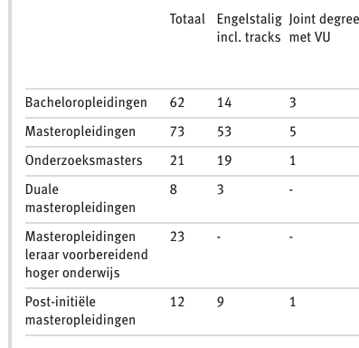
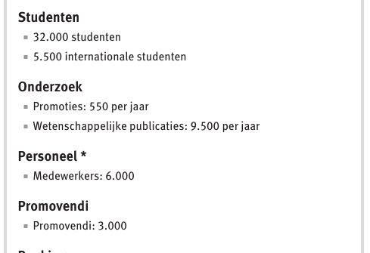
The University of Amsterdam in #s

Slide 5
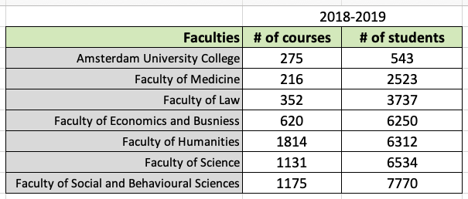
#of Students and #of Courses per faculty
Notes:
Different “parties” at the table. When central services speak to us they often make the mistake of viewing us as the same

Slide 6
Basic architecture - accounts
Accounts per faculty
Account Roles

Slide 7
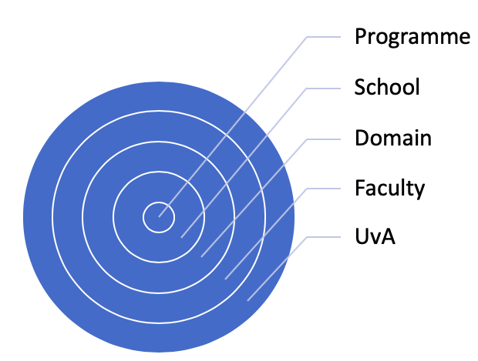
Sub Accounts in Canvas

Slide 8
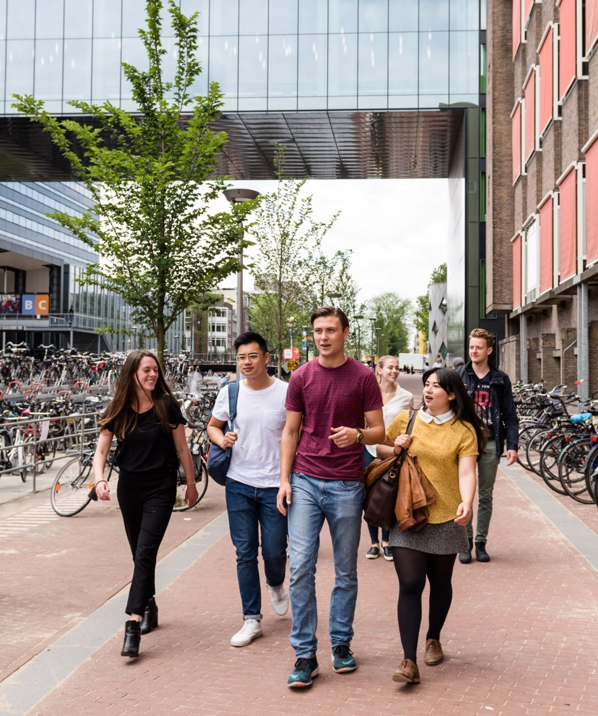
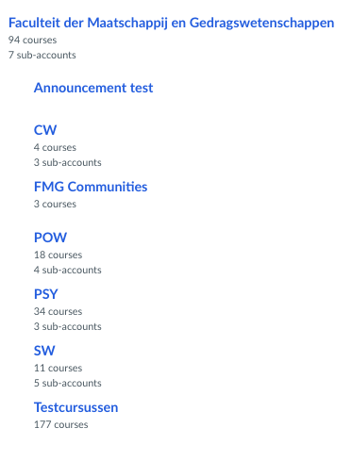
Faculty of Social & Behavioural Science (FMG-UvA)

Slide 9
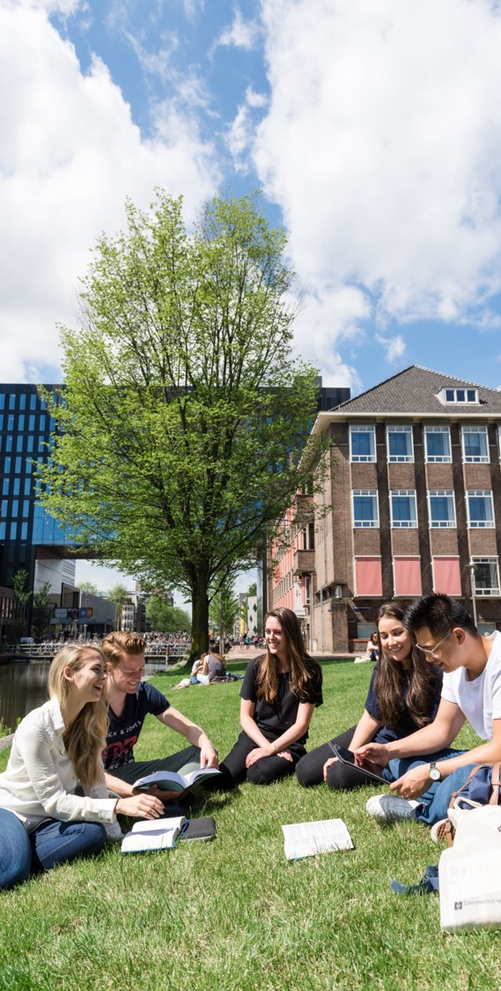
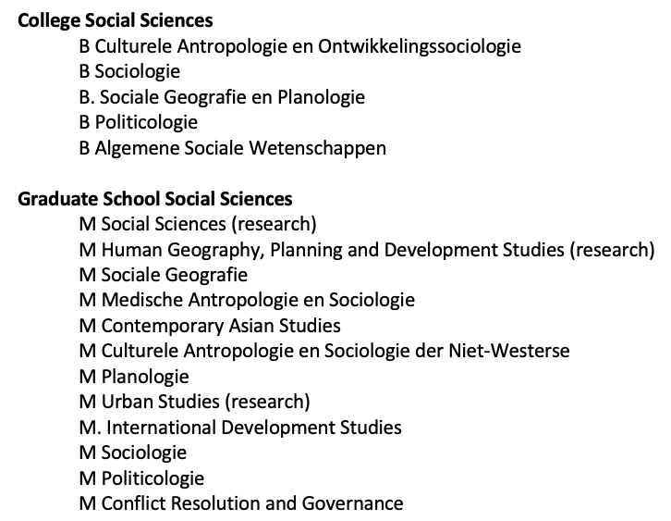
Social Sciences
Notes:
All the study advisors and programma coordinators kan manage their own educational programmes

Slide 10
The different account roles we use are:
View grades
View content
View enrollments
Change content & people
GDPR compliant
One of the 40 “instalación decisiones”

Slide 11
Decision making structure
Programme team (met biweekly)
Programme manager
Faculty projectleaders
Central services project leaders / specialists
Steering Group
Programme manager
Director per faculty
Notes:
Used Canvas as our project workgroup environment

Slide 12
Decision making structure in FMG
4 ”schools” 4 EdTech teams = project workgroup
  Met weekly
Advisory group
Steering committee

Slide 13
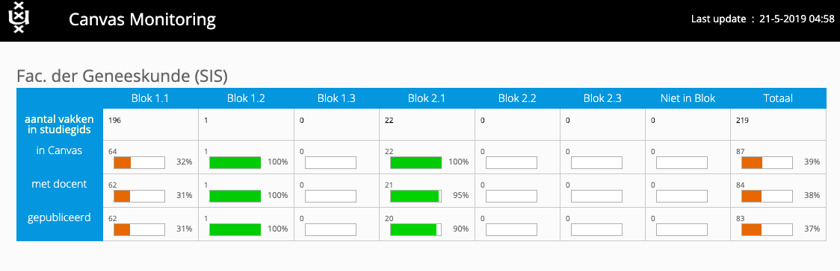
Monitoring tool
Notes:
Very usefull also because the different faculties are managed differently and everyone can access and see how their school is doing

Slide 14
Training of Teachers
Teacher Assistants (not all faculties)
  Non threatening for teachers
  Explain the student perspective
  Give confidence
Training organized per faculty
  Generic UvA wide canvas training, in Canvas, adopted from the VU
  Specialized training per faculty
  Every week, different times 6 months
  At the end, online video
  Tracking of teachers
We started with a 15 minute meeting – last time in BB….

Slide 15
Main points in training
It is not dropbox, it is a timeline
Personal notifications
Turn off unless
Wow elements
  Forum: post before reading
  Scheduler
  Mail students who…
  Drag and drop
Every teacher received a course to “play” in… automated
Notes:
User interface is great

Slide 16
Free for teachers….
https://canvas.instructure.com/enroll/BMLJFE

Slide 17
Some course elements
Navigation with profile tools
  Inbox
  Notifications
Courses, sections, groups
Issues
Grading
Learning Analytics
Integration with roster

Slide 18
What is what ->
with Crosslisting and BluePrints
Added Value
How a course in Canvas is born
Sections and Groups in Canvas
Crosslisting & Blueprints

Slide 19
Added Value
The architectural options in Canvas can help your students and teachers especially in:
Large or small courses with independent workgroups
Bilingual courses
Thesis Seminars

Slide 20
How a Course in Canvas is born
Groups:
Assignments, presentations, etc
Course
Workgroup 1
Workgroup 2
Workgroup 3
Workgroup 4
Group assignment 1
Group assignment 2
Group assignment 3
Group assignment 4
In Real Life
Y Activiteit
W activiteit 1
W activiteit 2
W activiteit 3
W activiteit 4
In SIS
Canvas Course
Section 1
Section 2
Section 3
Section 4
In Canvas

Slide 21
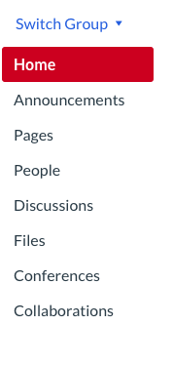
Sections & Groups in Canvas
Section
Automatically generated from SIS
Teacher still the boss
Show/hide assignment for section only
Email section members
No section tools
Group
Manually or selfenroll or per section add a group…
No hierarchy
Group Assignment
Email group members
Group tools:

Slide 22
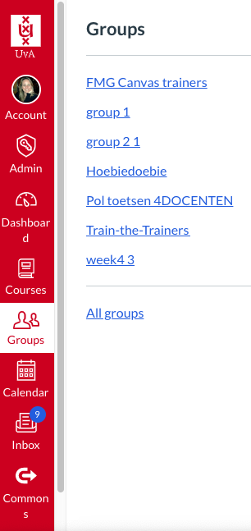
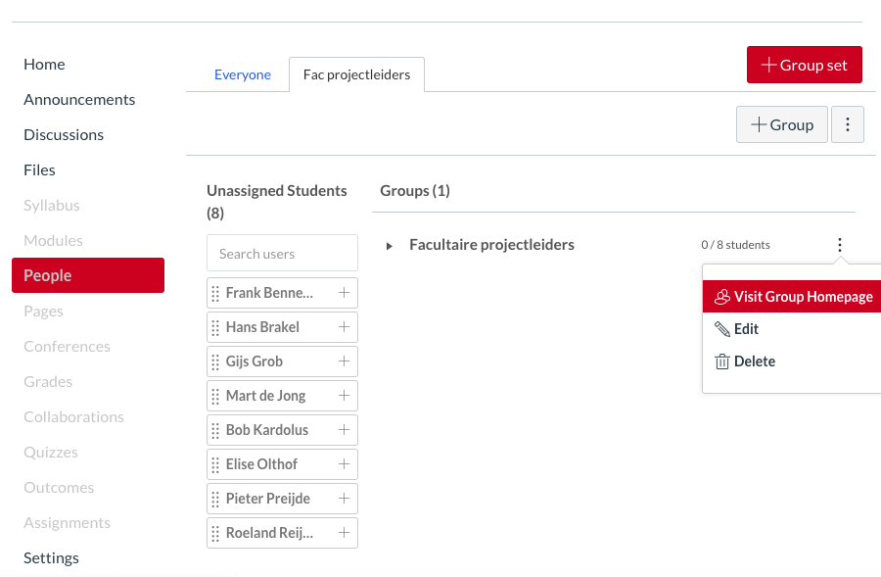
Group in Canvas course

Slide 23
“Crosslisting” in Canvas
Canvas Course
Section 1
Section 2
Section 3
Section 4
Blueprint
Course
Manually created Dynamic link
Content
Content
Content
Content
Manually created courses
Crosslist course 1
Crosslist course 2
Crosslist course 3
Crosslist course 4

Slide 24
Things to know…
Once a course is crosslisted, students can no longer access the content in the original course
A course can only “belong” to ONE Blueprint course
The content pushed from a Blueprint can be “locked” or not
The structure will need to be built manualy each year, on request basis only

Slide 25
Work necessary
Manual work by edTech team
Assume teachers will need instruction/training
Communicate to students

Slide 26
External tools
Library; the library has built an integration in Canvas so that teachers can easily embed digital literature we have available in the courses
Mediasite integration
Grades
Course Catalogue

Slide 27
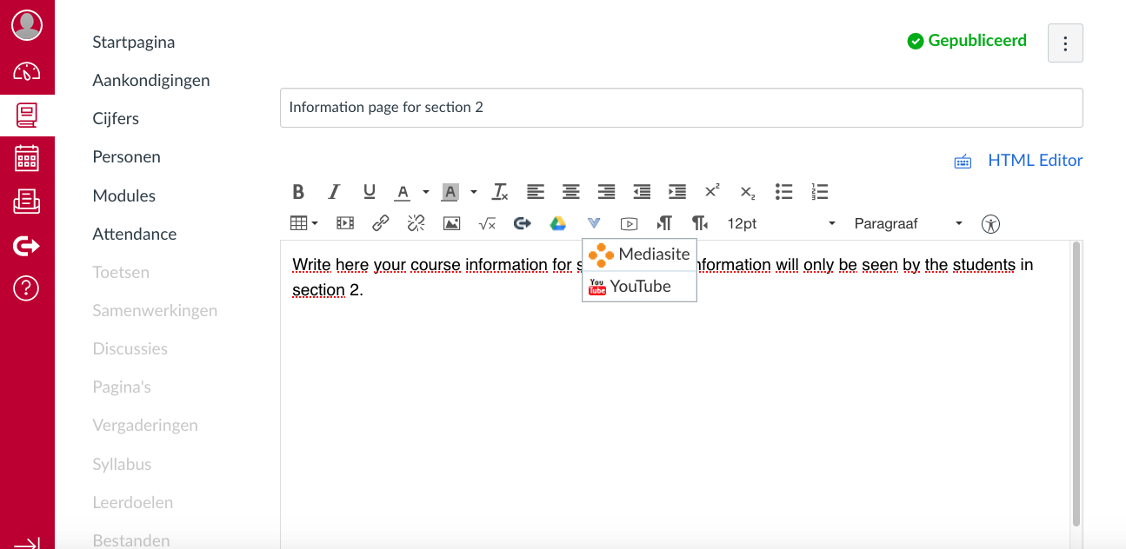


Slide 28
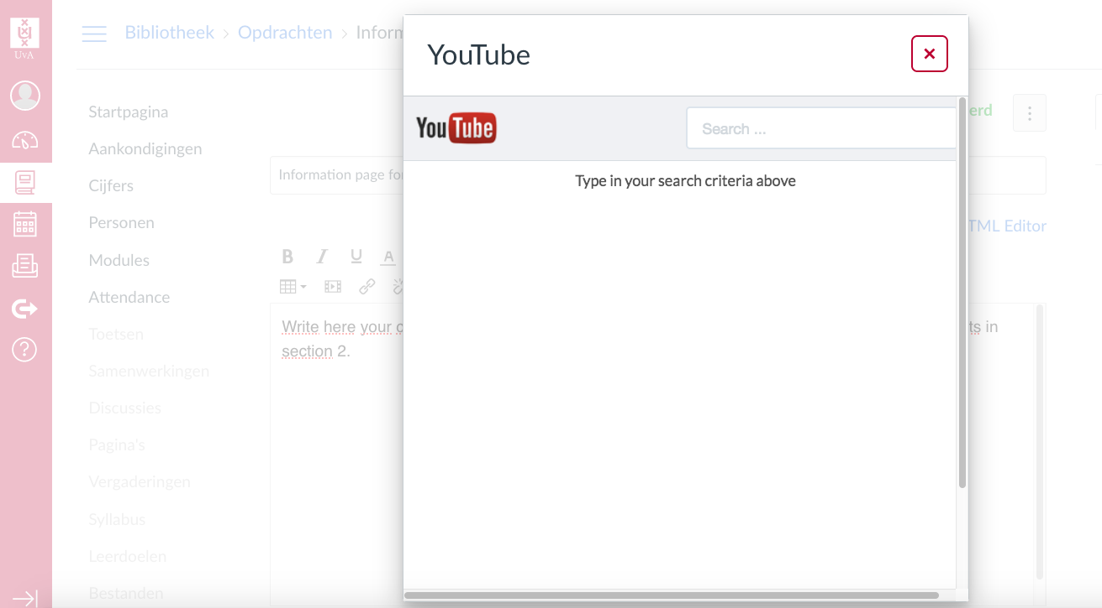
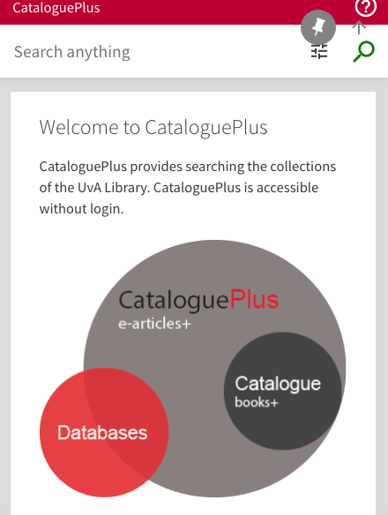


Slide 29
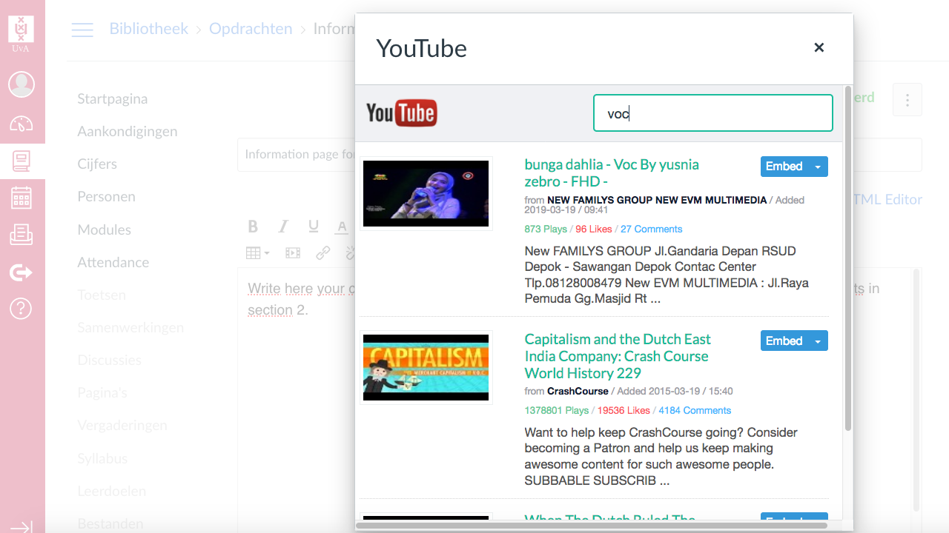
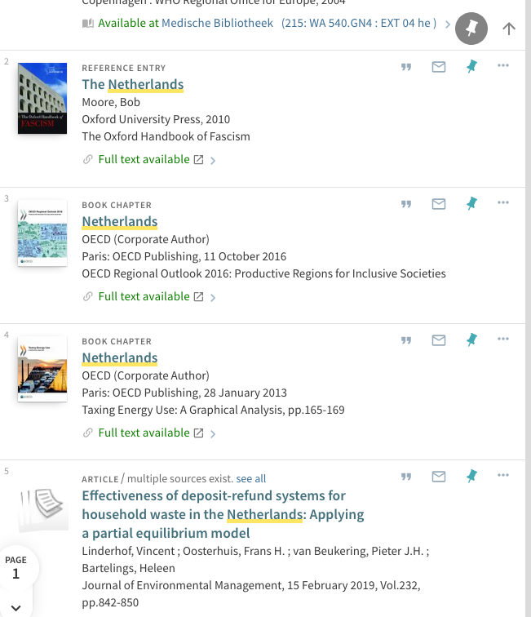


Slide 30
New developments after implementation
Cohort classes
Study associations
Education committee
Accreditation
API skills

Slide 31
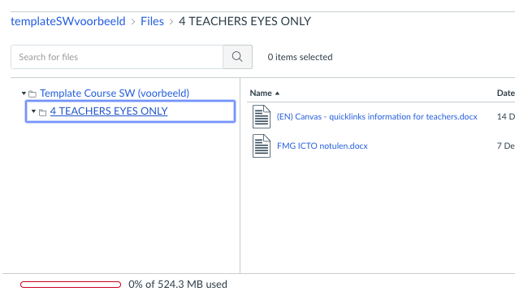
Info for teachers

Slide 32
Current stakeholders
UvA
Teaching and Learning Center per faculty
Change Advisory Board Canvas (projectleaders)
Digital Learning Environment board (steeringcommittee)
University Committee on Education
Netherlands
Dutch Canvas User Group

Slide 33
Thank you

