Slide 1
EVENTOS
2019
XVII Jornadas CRAI
The Added Value of Learning Platforms
By: Nynke Kruiderink, University of Amsterdam

Slide 2
Who am I
  Projectleader Implementation Canvas & Teaching and Learning Coordinator for the faculty of Social and Behavioural Sciences
Purpose of this presentation
  Reflection and context

Slide 3
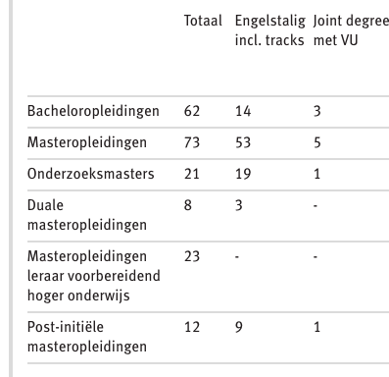
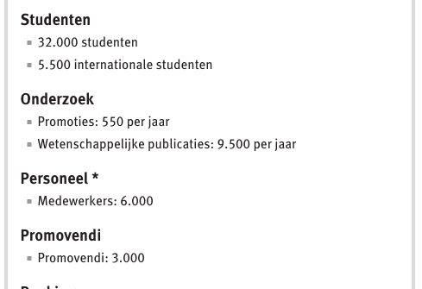
The University of Amsterdam in #s

Slide 4
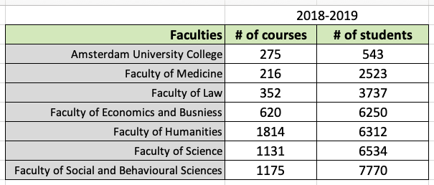
#of Students and #of Courses per faculty

Slide 5
The Dilemma of the added value of Platforms
Added value for whom?

Slide 6
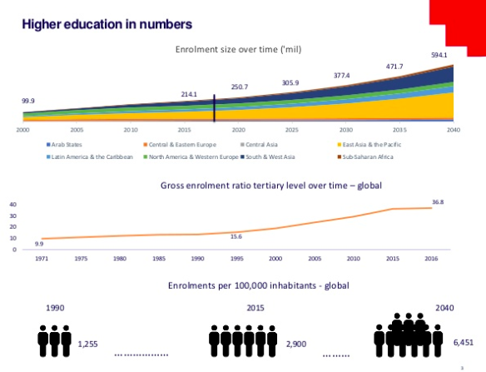
Notes:
Source: “Massification of Higher Education Revisited” Angel Calderon
https://www.slideshare.net/AngelCalderon11/massification-of-higher-education-revisited
Notes: Global trends growing number of students

Slide 7
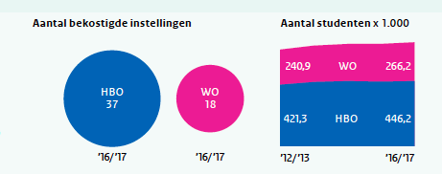
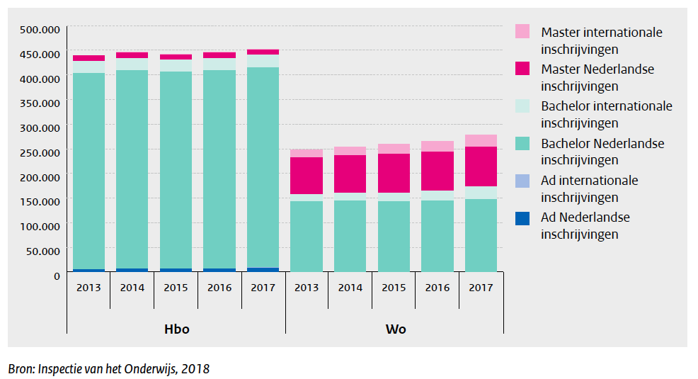
Netherlands HE in
Numbers
Notes:
Dutch trends in higher education (Vocational higher educational Institues=HBO and Academic=WO)
Totaal amount of HE students=almost 700,000
Increased amount of students
more hetergenous group of students (les elitist, more international)
Less money per student

Slide 8
% of 18-25 year olds enrolled in HE

Slide 9
Issue #1)
Student diversity is increasing
Due to increase in absolute numbers, so no longer the best of the best
Due to migrating students, student body becomes more heterogenous

Slide 10
Issue #2)
A more heterogenous group of students is more difficult to facilitate and teach. More difficult means:
Extra costs
Looking for new solutions

Slide 11
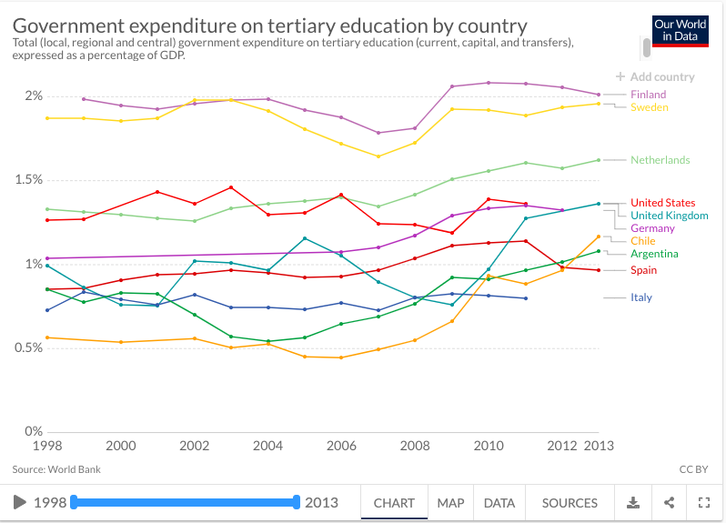
Notes:
Source: https://ourworldindata.org/tertiary-education
Graph shows government expenditure. Finland is often an educational example, they invest!
While budget has increased in NL….

Slide 12
Notes:
Source: https://www.economist.com/taxonomy/term/76972/Banyan?page=1153
Director once said “Harvard has a larger budget than all the Dutch Universities combined”

Slide 13
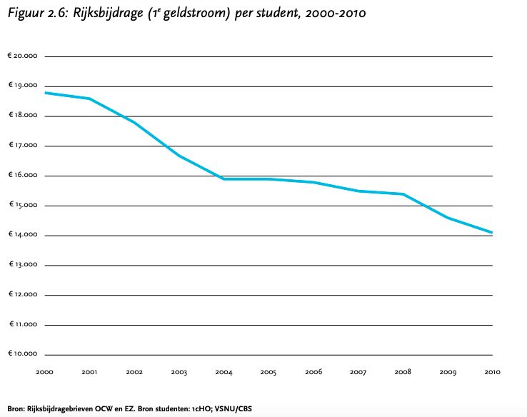
NLs Government € contribution per student
Notes:
Source: https://www.vsnu.nl/files/documenten/Publicaties/Trendrapportage_DEF.pdf
Less money per student

Slide 14
Issue #3)
Rising numbers of students, less money available per student
=
We have to do more, for less.
Can a LMS help with this?

Slide 15
LMSes an overview

Slide 16
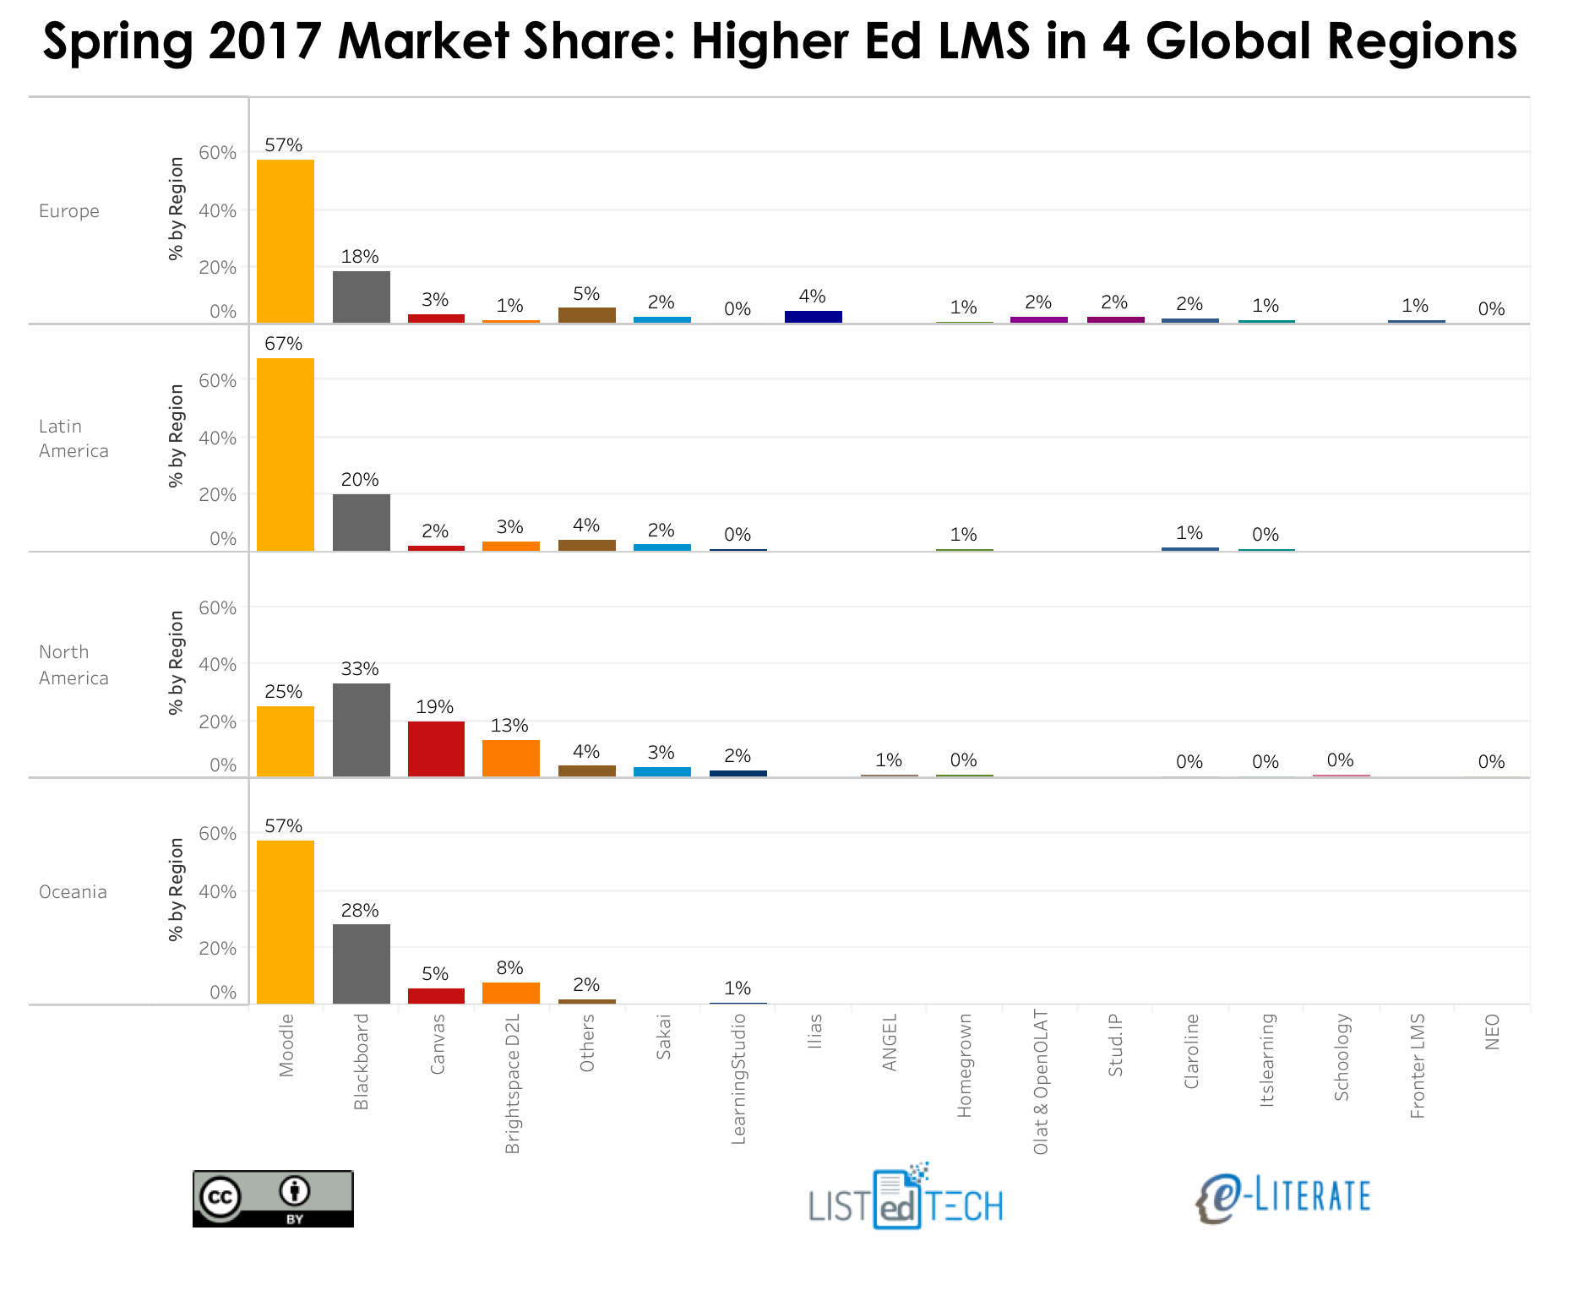
Notes:
LMSs globally
Moodle big contender, then Blackboard and then depending on which region, Desire to learn or Canvas. For UvA these two were also the finalists.

Slide 17
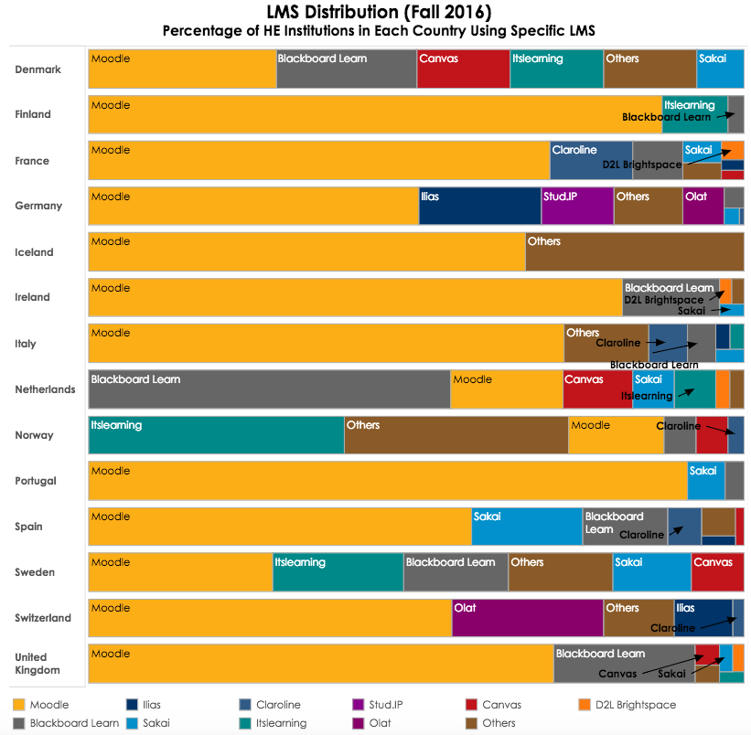
Notes:
LMSs in EUROPE, by country
Blackboard very large in NL, I don’t know why
Moodle large in Spain

Slide 18
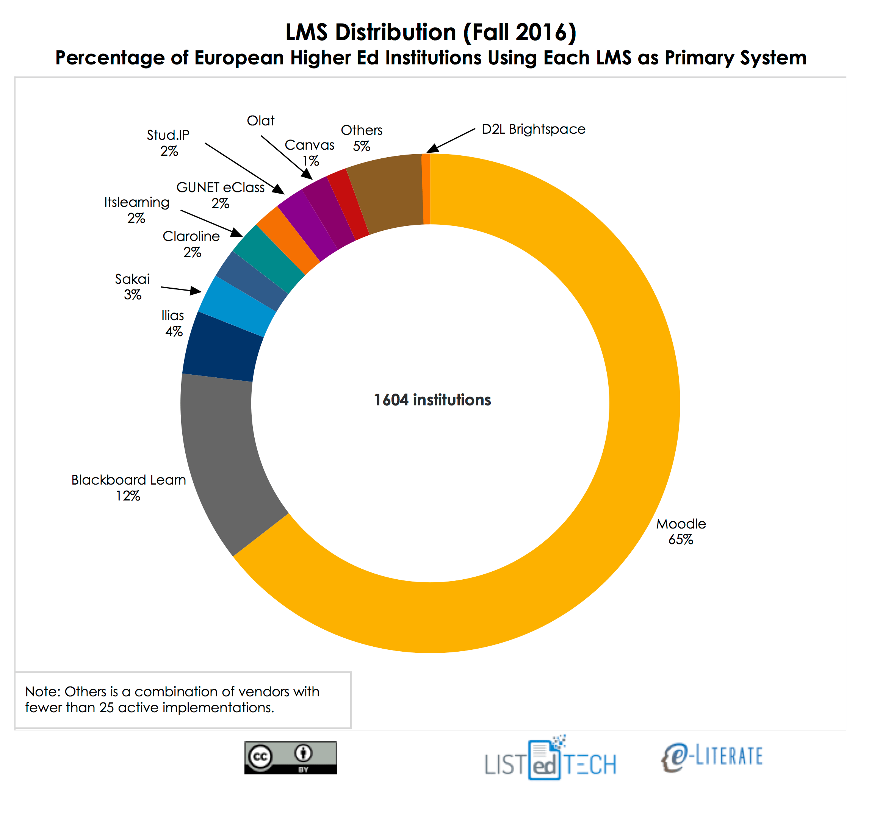
Notes:
Total LMS distribution in Europe
But this isn’t the real story…..

Slide 19
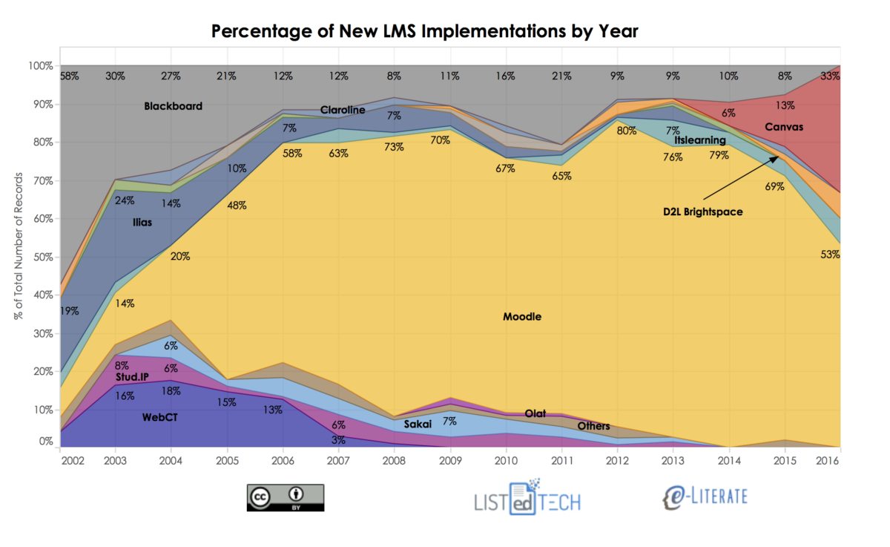
Notes:
The growth of Canvas is the real story, and D2L right in it’s slipstream.
Why is that relevant?

Slide 20
Notes:
Source: https://elearninginfographics.com/top-lms-industry-facts-2016-infographic/
Well if we look at some LMS statistics it becomes clear why that is relevant.
The LMS market is growing very strongly. This makes it attractive for new investors, new actors & players.
The LMS market is not only aimed at education, but also corporate customers. That shifts their focus and interests of course. Influences roadmaps and choices in development and tools.

Slide 21
LMS Global Market Revenue
Predicted 16B$ in 2021
40% of film industry worth
10% of global TV industry
13% of global gaming industry
Notes:
Source: https://www.gamecrate.com/statistically-video-games-are-now-most-popular-and-profitable-form-entertainment/20087

Slide 22
Notes:
Growing amount of LMS deployments are hosted in the cloud.
That means that we as cutomers may or may not have access to the data, but the host certainly has access.

Slide 23
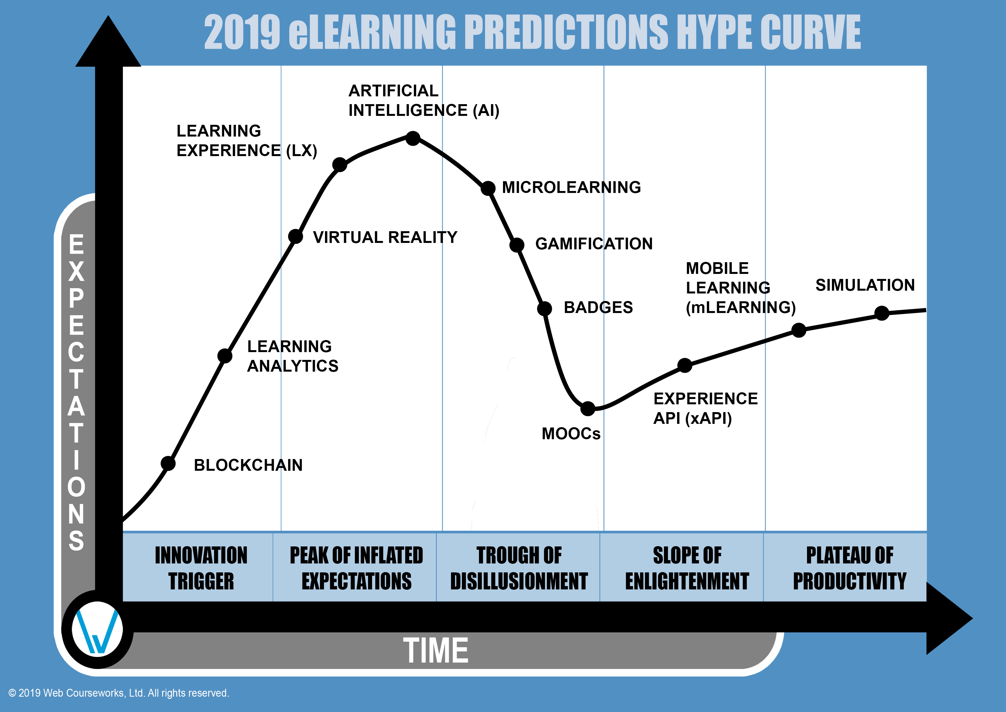
Notes:
Source: https://webcourseworks.com/elearning-predictions-hype-curve/

Slide 24
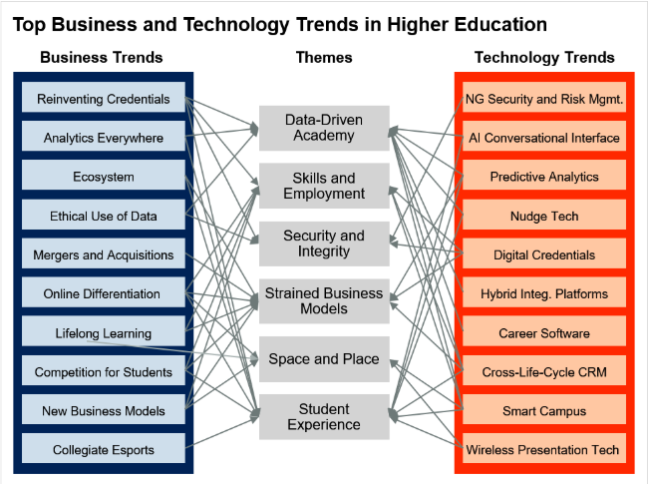
Gartner research: Top 10 Tech & Business trends in HE
Notes:
Source: https://www.gartner.com/document/3902468?ref=solrAll&refval=222590192&qid=73b101b8dde6ce5f8d
Research confirms that data driven learning is a top trend for the coming years

Slide 25
Issue #4) Data & Learning Analytics
Individual & adaptive learning paths
Deficiencies
Talent development
Higher return of investment

Slide 26
Revisiting Issues
Increased student diversity
Extra costs to facilitate diversification, shrinking budgets
LMSes offering solutions
Learning Analytics & Data offering solutions
Dilemma if HE is not in the lead regarding hidden norms and values in Platforms

Slide 27

Platforms
being built in Silicon valley
containing non-european morals and values

Slide 28
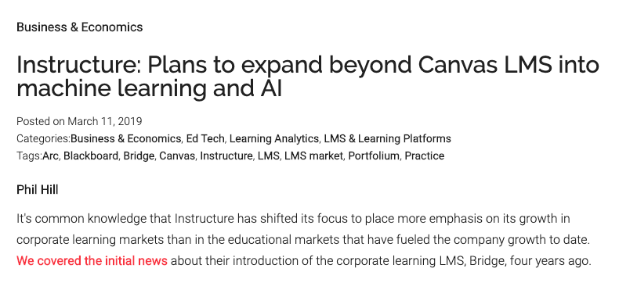
Instructure (Canvas)
“We have the most comprehensive database on the educational experience in the globe. So given that information that we have, no one else has those data assets at their fingertips to be able to develop those algorithms and predictive models.”
Notes:
https://mfeldstein.com/instructure-plans-to-expand-beyond-canvas-lms-into-machine-learning-and-ai/

Slide 29

Learning Analytics in LMses offer opportunities in an ever increasingly diverse and complex HE sector.
The demand for Learning Analytics and
Artificial Intelligence in LMSes is high
Technology companies should not be in lead
when designing the algorithms behind the
artificial intelligence
Notes:
And also this, will probably not revolutionize education.

