Slide 1
EVENTOS
2019
XVII Jornadas CRAI
A trigger to Collaboration: Creativity, User experience and Makerspace at
Uppsala university Library

Slide 2

Notes:
Linda

Slide 3
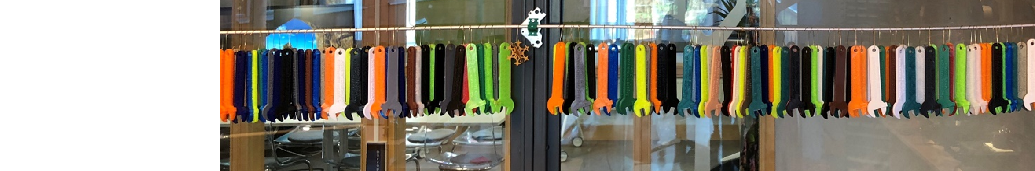
A trigger to Collaboration: Creativity, User experience and Makerspace at Uppsala university Library
Linda Vidlund
Sevilla
190522

Slide 4
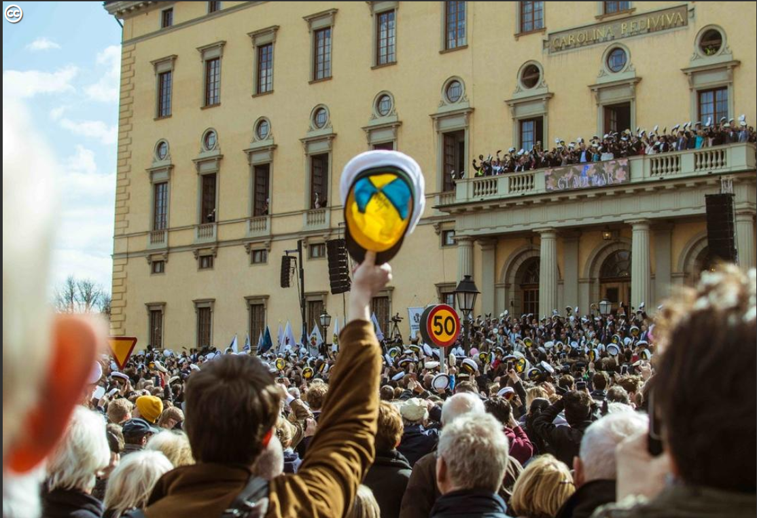
Uppsala University Library

Slide 5
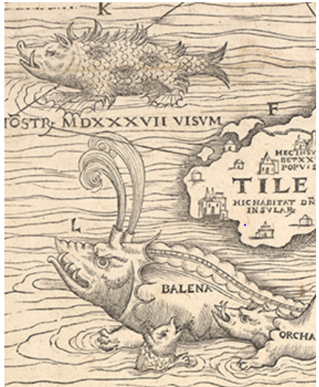
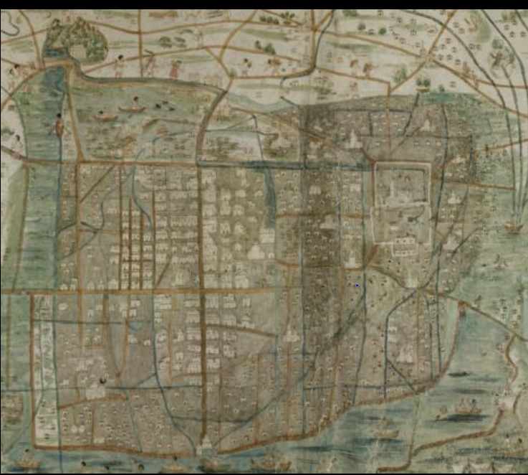
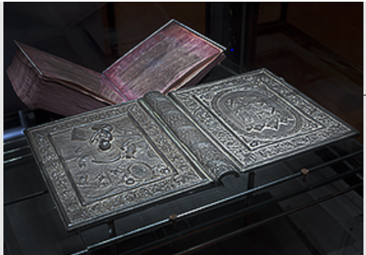

Slide 6
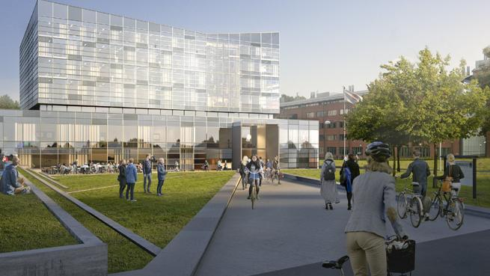
Pilot projects for a new building: Makerspace and Visualisation lab

Slide 7
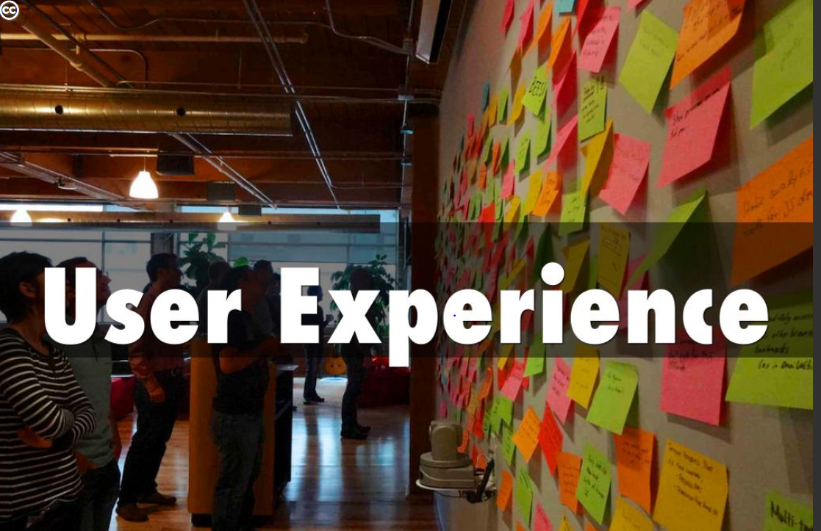

Slide 8
Example of methods
User journey map
Observation
Work as a patron
Love Letter/Breakup letter
Unstructured interviews
Grafitti wall

Slide 9
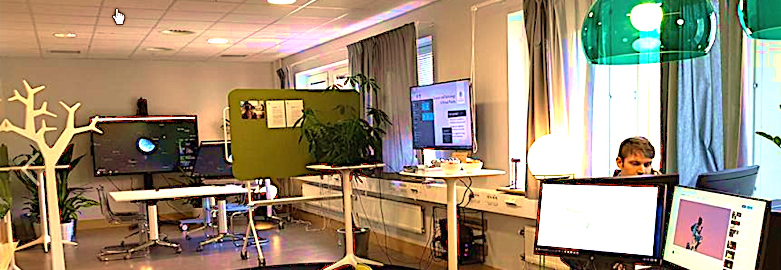
Ångström Visualisation Lab
Notes:
Linda: Ångström Visualisation Lab is a flexible and creative learning environment where you can explore data, multimedia and visualisation techniques.
Providing the new way of learning
By offering open creative physical meeting spaces in an attractive way, where you can explore models both virtual and digital there is a deepening of the studies. New innovative thoughts evolves through digital technique and modelling technique.
The visualisation lab is formed to offer different ways of visualisation and experiences. Different tasks and constallation of people needs different approach. We strongly encourage collaboration, and therefore is the room flexible and easy to change in the way the uses wishes.

Slide 10
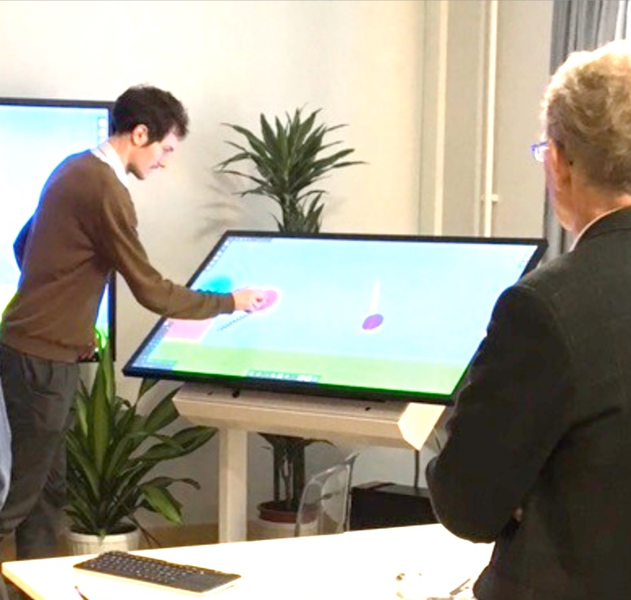
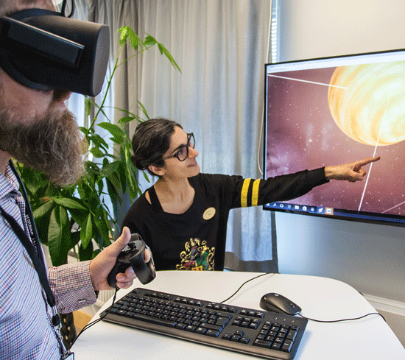
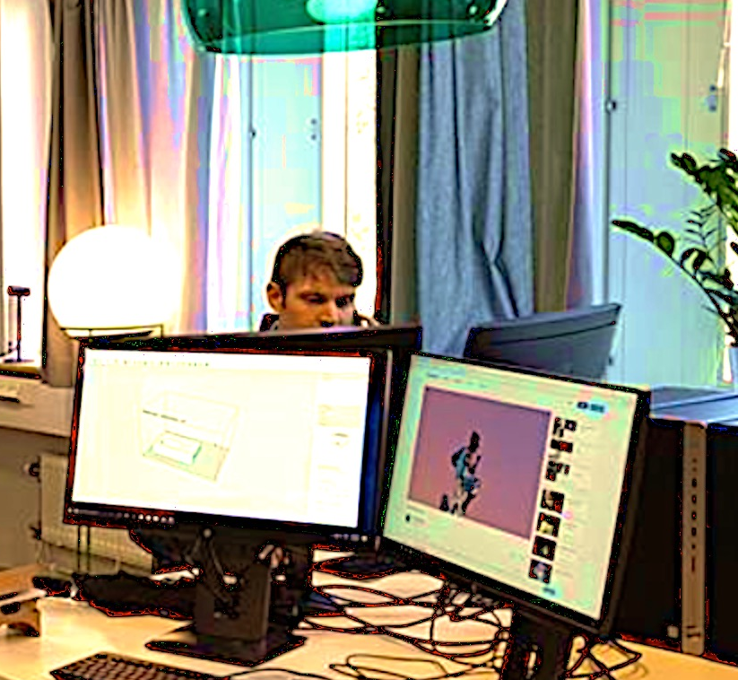
3 zones
Touchscreens
Virtual reality
Multimedia Station
Notes:
Linda: The room is divided into three zones. When the room is used for scheduled activities all the spaces are reserved for that purpose. Otherwise you are free to use any zone or seat that is not being used by others.
Zone 1
Vid en stor pekskärm som är kopplad med en ännu större vägghängd skärm kan vi skapa tillsammans, dvs vi kan jobba med en datormodell i grupp. Vi kan rita samtidigt och vi kan jobba på datorn tillsammans samtidigt. Detta skiljer sig från arbetssättet vid den individuella datorn där var och en jobbar ensam, och vi sitter kanske bredvid varandra, men bara en person kan jobba i modellen. Vid den stora pekskärmen delar vi upplevelse och jobbar interaktivt tillsammans i ett projekt.
In this zone you can find two screens, one to connect your own computer to and a touchscreen that you can use with your student ID and password A, as well as a table for group activies.
Zone 2
Virtual Reality (VR) spänner över ämnesområden från stadsbyggande & byggteknik till fysik och astronomi, idag – och är en given del i den digitala utvecklingen & vår digitala framtid. Genom att se besöka virtuella världar, kan vi granska ritningar och bedöma ännu inte byggda miljöer, då vi kan uppleva och bedöma platser virtuellt – det är enklare att förstå än att läsa en ritning eller höra någon berätta om miljon. Vi kan besöka platser virtuellt, kanske prova en resmiljö innan vi faktiskt åker dit.
Try VR! Borrow the controls needed at the library’s information desk. Courses
Construction Engineering: VR
Teacher Education programme: VR
Indtek
Astronomi
Zone 3
Experiment with visualization software and double screens, on your own or with a friend. Log on with your CAS-ID and password A and try out programs such as SketchUp, GIS, Adobe, MatLab or Python.
Visualiseringsdatorer
Vid starka datorer kan studenter över ämnesgränserna jobba med öppna dataset eller dataset från bibliotekets databaser för analys, strukturering och visualisering, med möjlighet för textmining och bildanalys/hantering. Här kan uttrycken & förståelsen förtydligas, med hjälp av visualiseringsprogram och andra verktyg.
Utveckla
förfina presentationer
Crossdisplin n(linda) På G
program

Slide 11
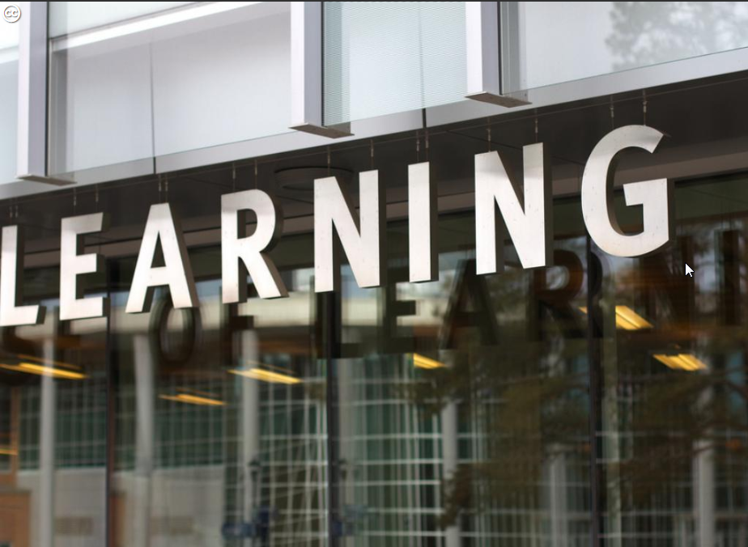
How teachers use the space
Notes:
Petra: As an architect and teacher in civil engineering I use the VisLab in my courses for designing houses.
Traditionally we work in computerlabs, where the student construct their houses as a model and make drawings and descriptions as a result – output. We use Revit a BIM program (Building Information Modeling) , where every part in the model contains information, like material, coluur, price anything yous want, while there is a database linked in the program.
The construction company NCC, with which the university has a partnership with, wanted to support our education in civil engineering with a VR station, while VR is a new technic used in business. We then decided to make this equipment avaible for everybody at the university, not only for the civil engineerings, to get a effective use (technics get old quick)
& explore what happens when the use isnt controlled – when avaibility is free, what new outcome would that make? What happens when VR station is placed in a context with even more new technics?
Students gets new tools i tiden, new ways of collaboration i tiden
Work in team, samarbeta, kala in folk & kompetenser – komplexa projekt kräver det
Outcome VR; evaluate, discussion, experience, find faults and improvements, Outcome Touchscreen; preparation for the examines in groups, easy to see /change in the presentation, sitting round table Outcome Multimedia; refine their presentation
Outcome VR; testing the technic
Outcome Multimedia; exploring which software
Petra: So whats in the room (Tech) and what kind of teaching is possible? Pedagogy and outcome of new teaching -Images
Creating a room that’s appealing- to think about
Engagerar
Upplever
Samarbete social (hållbarhet)
Ökar teknikintresset

Slide 12
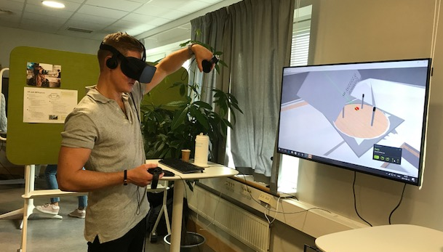
Virtual Reality
Experience and explore your problem or task
Notes:
Petra: In year 2 they design multistory buildings, now they design their building in groups of four students ,using the software Revit.
In this complex project, similar to a real project outside the university, it is a lot of building regulations, they have to fulfill, to get examinated
Like fire performance, disabily claim, where measure f the buildings must be correc, as well as choice of aterials & construction type heights of room etc, etc
Here the VR station is a opportunity for the students to review their projects, before examination, its 3D for real, not 2D 3D They move inside the building, eith th googles on and it feels really ral, if go onto a pillar, it feels unpleasant –so in VR they can understand their design better, while in the VR you feel & exeperience the building.
Inside the VR you can point at a wall, and get a sign which tells you the content of the wall.
Outcome Touchscreen; preparation for the examines in groups,
Traditionally we review the students drawings, now we can have cpmplem discussions with them at the VR station.

Slide 13
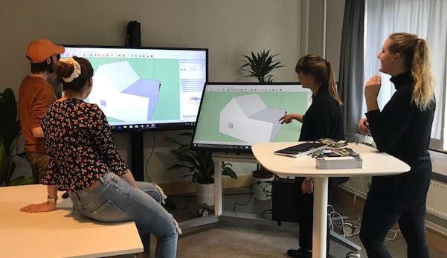
Touch screens
Supports interactive joint work
Notes:
Petra: In year 1 the students design small houses, and they first make this individually, by making a simple volume of their houes in the free software program SketchUp. In the first part of the course
Very early in the course they evaluate their drafts in small seminars, by the big touchscreen, and in VR.
In the serminars they dicuss what they have done & why, inclusive failures, & they get critized by their student friends– what is good, what could be improved– is that that here you interacshow change in the modelt - you are close in a small group not a frontal presentation, nice respons (while close), immediate change in the model, interactive , helping eachothers
We achiev- you feel togetherness, It gives them a feeling of meaning., safe – easry to learn in such enviroment
AchivecKnowledge , while sharing the project in the gruop
This zone is the most poular zone, and get the best pedagogic outcome, of understanding & comptence
Thereafter they continue designing the details and drawings in the software Revit, The students likes the the Big Touchscreen zone the most, while making together vs individually making, presentation
– The different part here from traditionally seminar , where you show drawings powerpoint, just talk

Slide 14
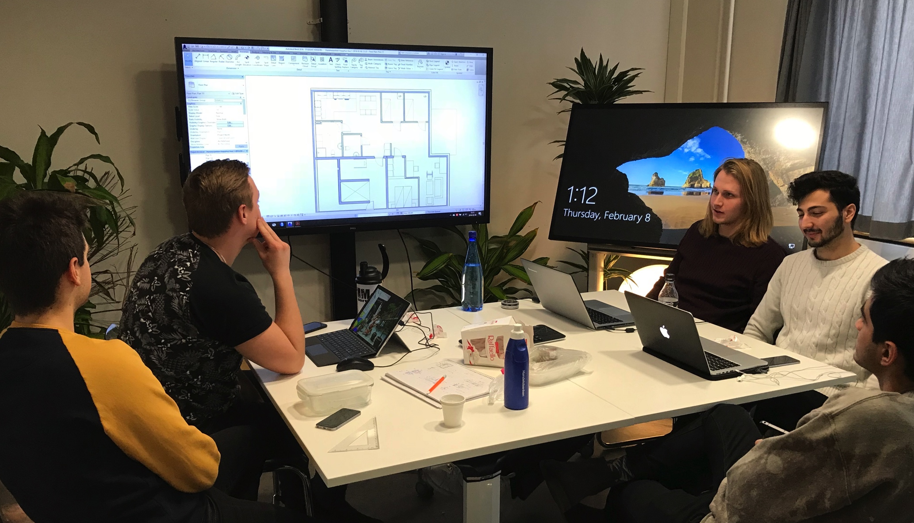
New technics new pedagogy understanding
Notes:
Petra: New technics new pedagogyStudents works in Groups Peer to peer,
Dicuss and interact
Thiscould a useful examination (have not tried it yet)
Achiev goals as knowledge, understanding & competence
Complementary way of output
providing collabarion, exploring, understanding, and thereby comptence
New- everybody can work simultaneously of the project
By using the new technic, we reaches Knowledge
Understanding
to experience in VR, understand the use, the size, the construction, the light etc
Competence, The technic supports teamwork; discussion, helping each others
agree
Teamwork
Sustainability
Presentation
Ethics; discussion
Traditionally technic; Drawing vs new technicsVR
Traditionally Drawings, hard to read, take lots of years to understand size, volumens, sections, voids, to read a plan & section togheter to make a 3D in your head
VR ; realize the use , feel it, understand immediately

Slide 15
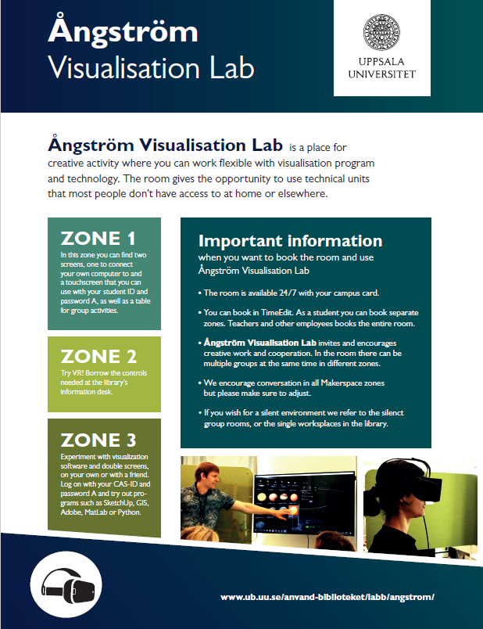
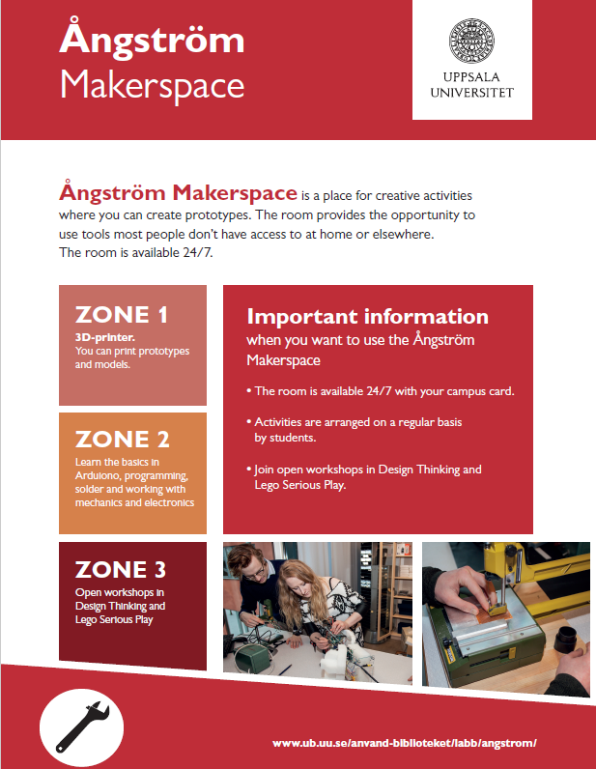
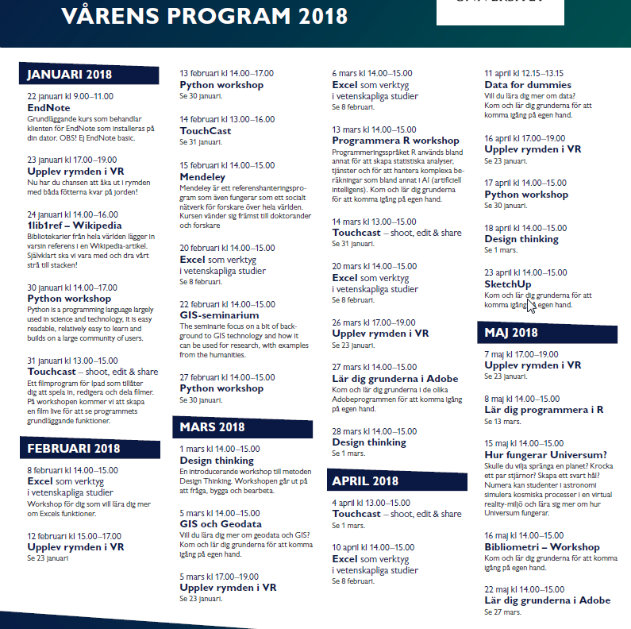
Nothing without acitivites
Notes:
Linda: the spaces is nothing without activities. Therefore we worked a lot with the concept for our presentation of the programs/ activites in lab and makerspace.
We aim to attract peoples couriosity and who perhaps dont do for example programming in their ordinary courses, or just want to try something new. Everyone is welcome! Just come and try

Slide 16
Librarians, teachers, students and researchers
Librarians: excel, design thinking, reference management etc
Teachers: VR in different programmes like Construction Engineering or Astronomy
Students: VR in space and 3D-printing
Researchers: different talks to inspire students, cross-discipline collegues and the public

Slide 17
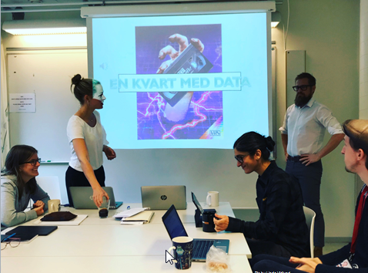
15 minutes of Data
Notes:
Work with open dataset

Slide 18
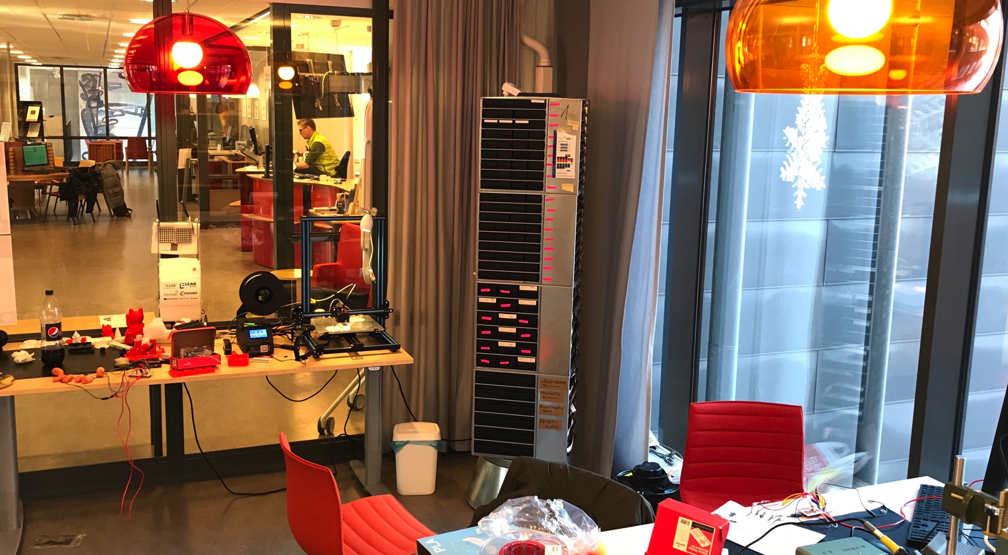
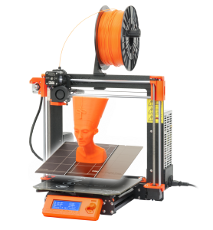
Makerspace
Notes:
Linda: In the library we now have two new creative spaces. Those spaces are test beds for project development and research of new free creative innovations within Sceince and technology. Those spaces are formed by user experience methods and are constantly evolving, We listen to the users to be sure we have the right equipment and technique within visualisation and modelling both virtually and physically.
Here you can see our makerspace: how can the more tactile ways through mecanics, engineering and 3D-printing support the learning at the university? By letting students using their creativity both in projects connected to school and on their free time, they get energy and feed their brains with learning that is not possible in the traditional environment.
In Makerspace there are opportunities to use tools not available at other parts of the university or at home. You can get guidance by students, phds, teachers, librarians through workshops, drop-in during the day or at focus nights.
Bachelor Programme in Electrical Engineering: 3D-printing and Arduinos
Student driven workshops with Arduinos, programming and 3D-printing
Lego Serious play (teacher)
Design Thinking (Librarians)
The room is open 24/7 for own projects with opportunities to be guided by a teacher or students. This is the place to work threedimensional with models an important part to understand mecanics, electronics for construction and so on, to generate ideas and try new things and make prototypes. New users can explore things and use tools they havent tried before.

Slide 19
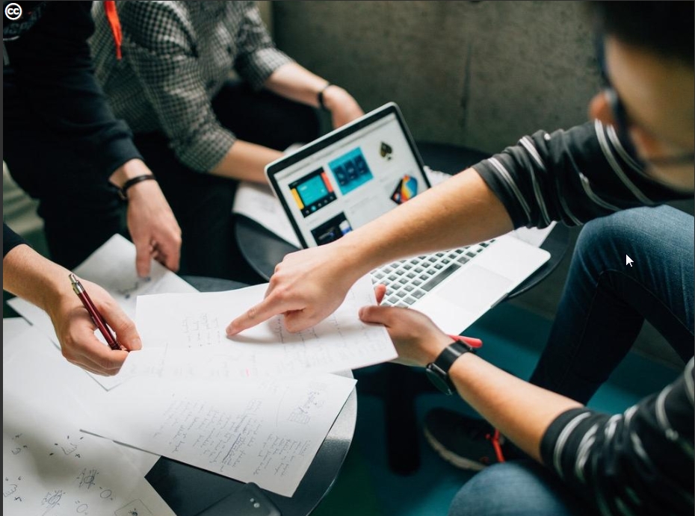
Student co-workers

Slide 20
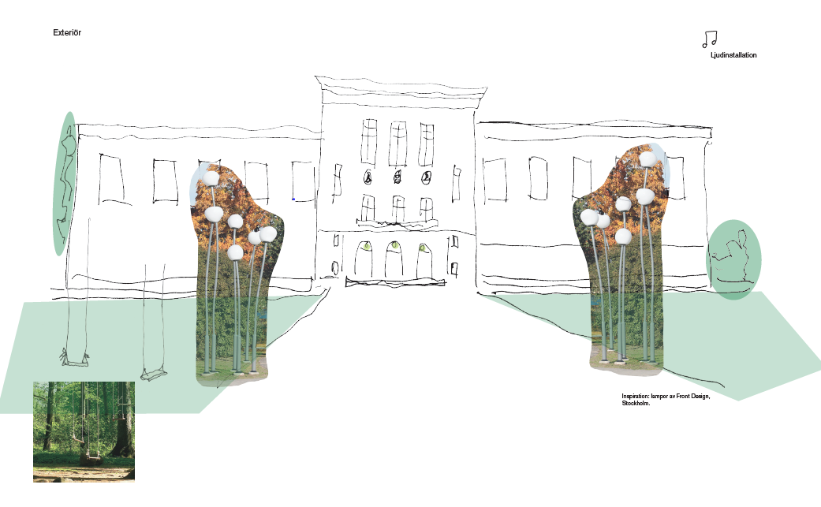
Biology Library

Slide 21
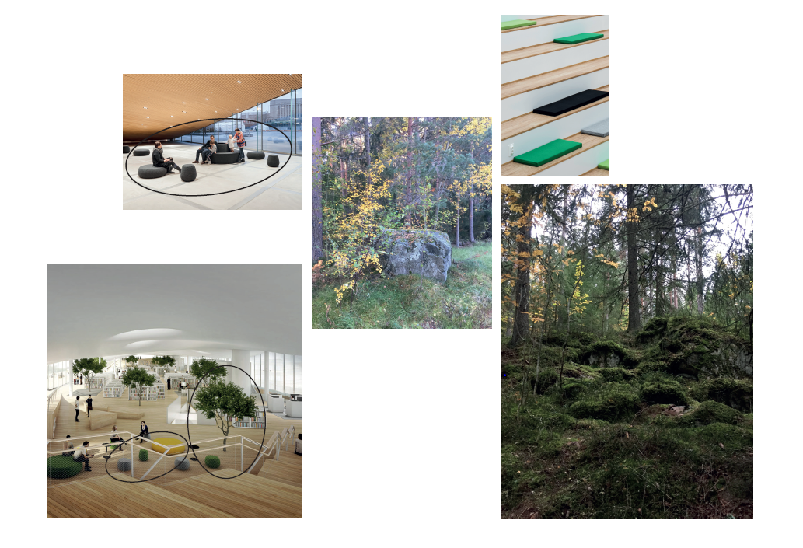
Creation by a scenographer

Slide 22
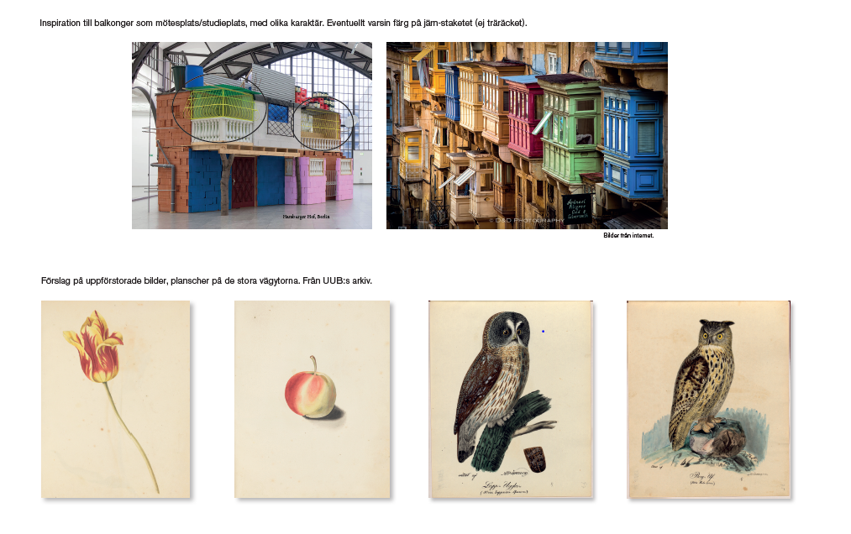
Inspiration from our old collections

Slide 23
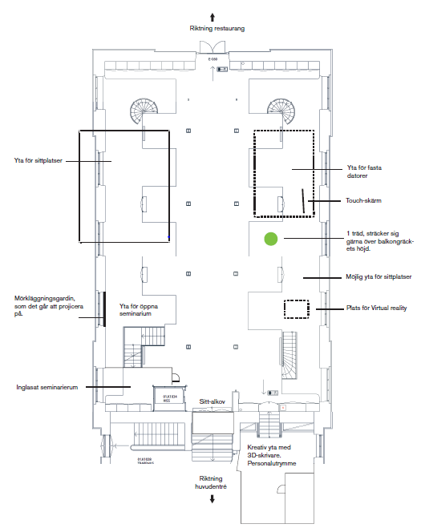

Slide 24
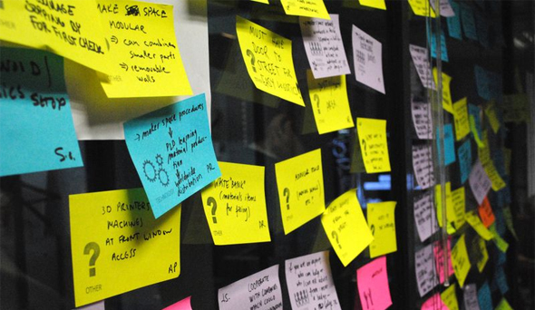
Collaboration

Slide 25
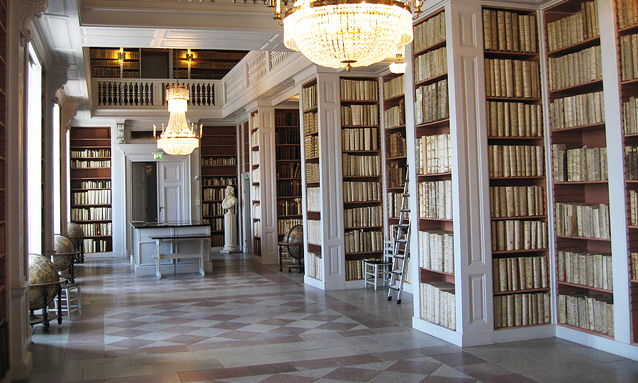
Why the Library?

Slide 26
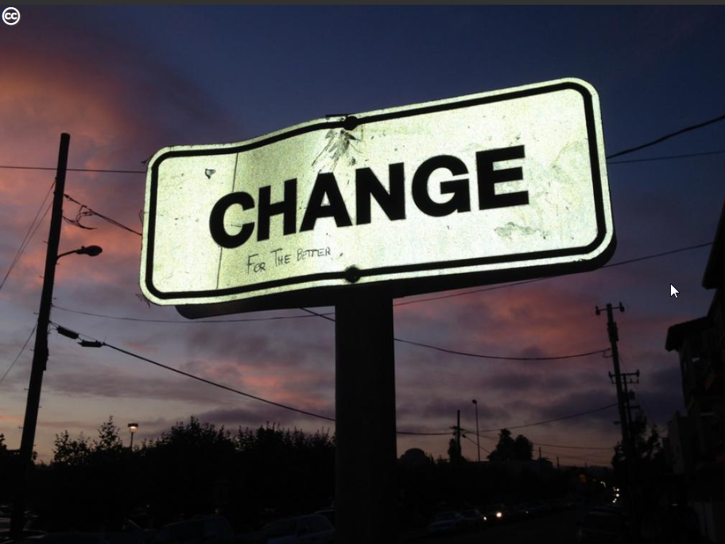
A project for change

Slide 27
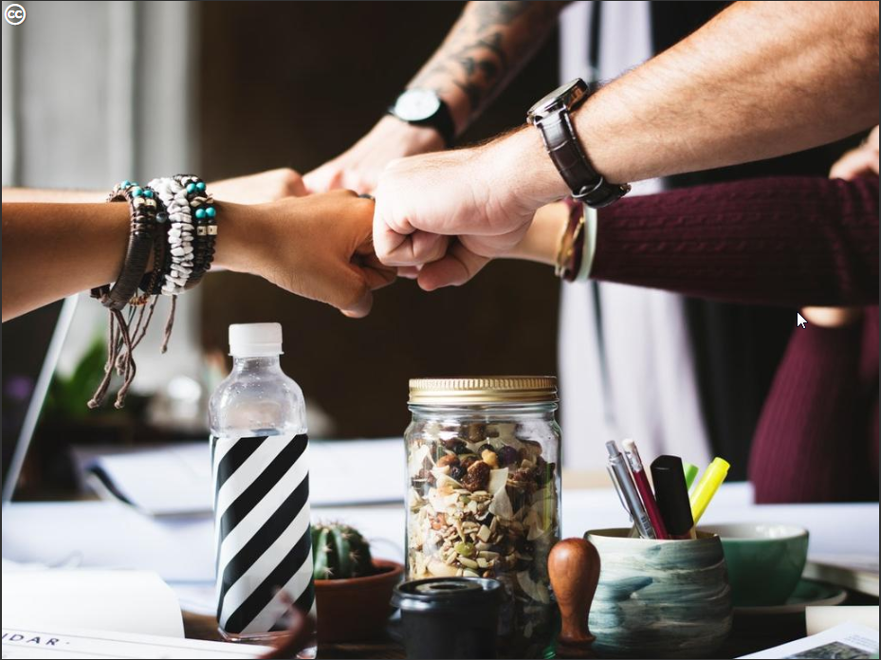
Success factors

Slide 28
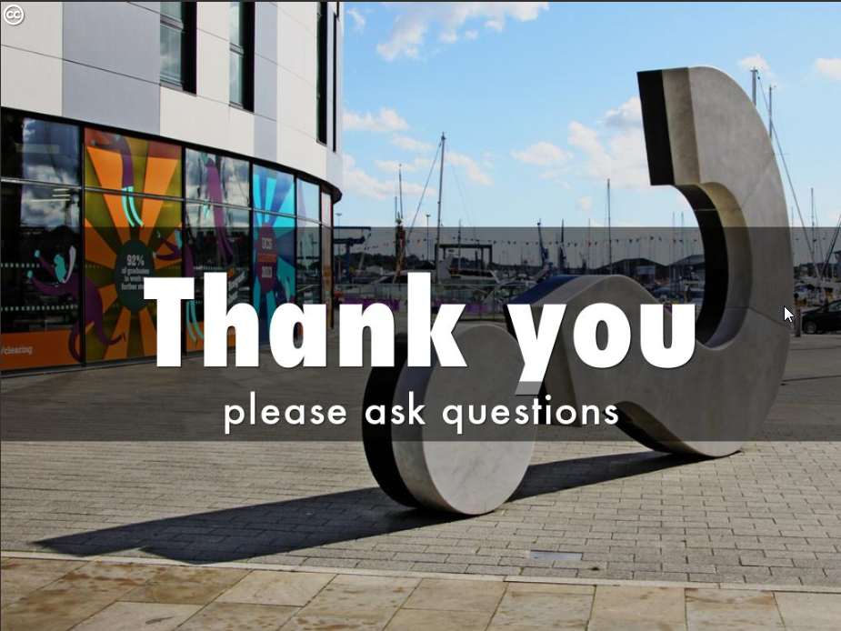
Linda Vidlund
linda.vidlund@ub.uu.se
Twitter: @LVidlund

