Slide 1



Getting Wired – lessons from a decade with the e-learning five-stage model in distance learning courses.
Henrik Kaas
E-Learning Consultant
IT Learning Center
Faculty Library of Natural and Health Sciences
Frederiksberg Campus
Notes:
Hello – I’m Henrik Kaas and I’m an e-learning consultant at the University of Copenhagen in Denmark

Slide 2
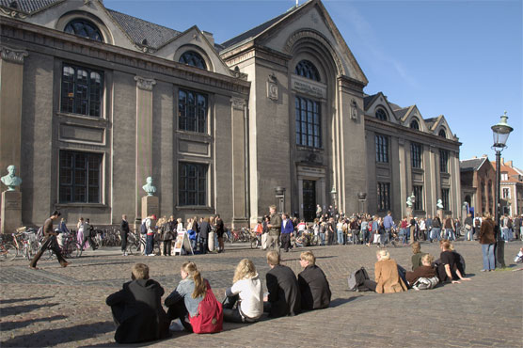
The University of Copenhagen
Notes:
I’m from the University of Copenhagen, which you might have guessed. This is the old university building in the centre of Copenhagen where the university started more than 500 years ago.
These building are from 1811 because the university burned down when the English bombed Copenhagen and stole the Danish fleet.
This is up in the cold North so when we have a bit of summer the students come out to the square to soak up some sun. Notice the overcoats.
This was the situation just two weeks ago:

Slide 3
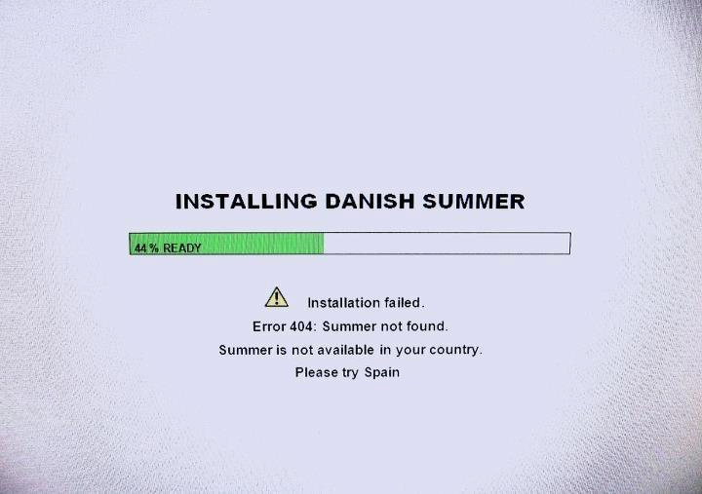
Notes:
This is from a computer at Danish Meteorological Institute. This is a situation we often find ourselves in in the beginning of the summer.
So I’m very happy to have been invited to this conference – as it says “try Spain” and I’m happy to be here to talk about some of the experiences we have with discussions in online distance learning.

Slide 4

Outline
Background
Learning through dialogs
Comparison of ‘face-to-face’ talk and online discussions
Starting with online courses
The five-stage model
How did we do it?
Did it work?
Further modifications
Notes:
Outline:
I’m going to tell you a bit about my background.
Some theory about dialog based learning
And how dialogs works online.
Then I will move to the situation before we modified the course
The solutions we found in the five-stage model by Gilly Salmon. I will go through the model.
Then a bit of how we did it
And the conclusions afterwards
Then I will finish with some examples of further modifications we have made.

Slide 5
Background
Notes:
A bit about my background

Slide 6
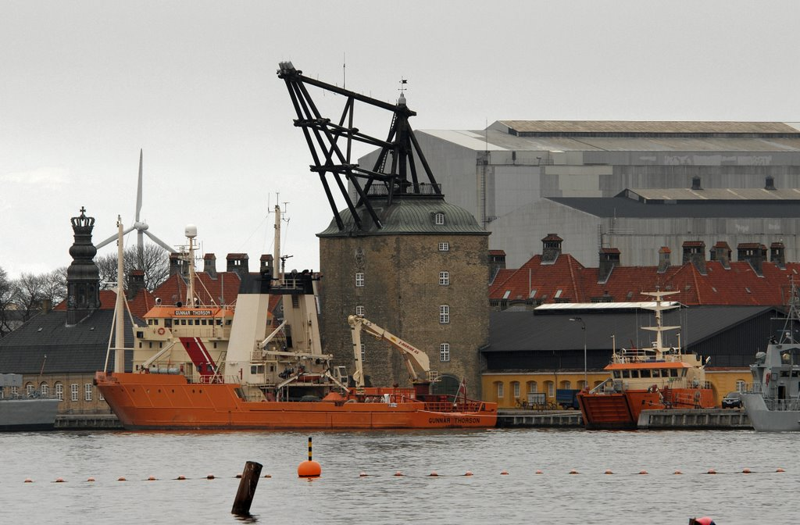

Gunnar Thorson
Notes:
I graduated many years ago from the University of Copenhagen as a marine biologist. I was doing research for some years. This is the ship I sailed with.
I then turned to teaching and communication. At first for a short period at the science museum in Copenhagen, the Experimentarium, then I became a teacher at the teachers training college in 1995 where I did my first teaching using ICT in a blended setting. In 2003 I started as consultant and system administrator at the Royal Agricultural and Veterinary University which was merged with the University of Copenhagen in 2007.

Slide 7
Faculty Library of Natural and Health Sciences
Notes:
This is where I work, The Faculty Library of Natural and Health Sciences, in a small unit called IT Learning Center

Slide 8
The IT Learning Center (ITLC)
The knowledge and competence center for online and blended learning at the Faculty of SCIENCE. The aim of ITLC is to enhance students' learning by integrating the use of IT and media in the teaching through collaboration with the teachers.
We are
1 Head of unit
1 Project manager
4 E-learning Consultants
Notes:
The IT Learning Center is a small unit at the faculty library. We are the knowledge and competence centre for online and blended learning at the Faculty of SCIENCE.
We are 1 Head of unit, 1 Project manager and 4 E-learning Consultants
To make a long story short we help the teachers to make online teaching both as blended learning and as fully online courses.
This presentation is about our experiences with collaborative learning using online discussions.

Slide 9
Learning through dialogs
Notes:
At first I will show why dialogs are important in the students’ learning

Slide 10
The transmission approach
Provider
Receiver
Notes:
One way of thinking learning is that knowledge is transmitted from the teacher to the learner in more or less one-way communication.
This will not be a 1:1 transmission but after doing some studying the result might be good.
Another way of thinking learning is that we learn better when we are collaborating. This is the basis of the learning theory, Social Constructivism.

Slide 11

The collaborative approach
Learning is an active process that takes place when learners engage in dialog and creates a common understanding
“My understanding” depends on:
Educational background
Cultural background
Age
…
…More perspectives
The common understanding is based on “own understanding” and “others understanding”
My understanding
My understanding
My understanding
Participant
My understanding
Common understanding
Participant
Facilitator
Participant
Notes:
In collaborative approach learning is an active process that takes place when learners engage in dialog and creates a common understanding. “My understanding” depends on: Educational background, Cultural background, Age etc.
The common understanding is based on ones “own understanding” and “others understanding”.
In this way the students are ‘teaching’ each other through the dialogs in collaborative learning and everybody will get a more common understanding even the teacher and there might even be a synergetic effect where the common understanding reaches beyond the “sum” of “own understanding”.

Slide 12
Maximize learning
Collaborative knowledge construction
“Level of learning”
Common understanding
Facilitator
Transmission of knowledge
Provider
Notes:
When we talk about enhancing learning the collaborate knowledge construction gives a much better understanding for the individual than transmission of knowledge. The focus is changed from content or curriculum to the students’ learning process. In other words the curriculum becomes at learning resource for the learning process.

Slide 13
The dialog in online learning
Students benefit from dialog
Discussion boards and chats are some of the online ways to facilitate dialog among students (and teachers).
Notes:
The importance of dialog in learning is well recognized in educational research and all learners seems to benefit from dialog. Without doubt, many teachers see discussion boards as the online way to facilitate ‘talk’ among students, especially if you have students sitting in different time zones.
But is it the same? I would like to point out some differences between oral and written dialog.

Slide 14
Differences between collaborating online and face-to-face
Permanence of online discussions and impermanence of face-to-face ones
Differences in group dynamics, with difficulties for interpretation of
behaviours online due to lack of non-verbal cues
Online discussions may have several simultaneous foci, whereas face-to-face ones
usually work on one issue at a time
Differences in level of moderator control and impact over participants’ behaviour
People can’t hide online
Differences in levels of anxiety
Psychological stress of joining a group is much higher online than face-to-face
Written communication requires more cognitive resources compared to oral
communication -> more reflection
Feedback on other’s work is much more detailed online than face-to-face
The total effort of the group is likely to be greater online than face-to-face
Yellow indicate a new topic
F2F
Online
McConnell (2000): Implementing Computing Supported Cooperative Learning. Kogan Page
Notes:
Here I will compare a face-to-face discussion to the left with an online discussion to the right. The animation tries to illustrate some of the differences.
You have an exact history of the online discussion while in oral discussion you have to take notes. Another advantage in the online discussion is that easy to reuse argument etc. in an assignment later in the course.
->In the online discussion you are missing non-verbal cues like smiling and the tone of a voice. In a written discussion it is for instance difficult to use irony as nobody can see that you are smiling while doing it.
->So you have to keep in mind that what you write can be misinterpreted. The use of emoticons or smileys is a way to emphasize the nature of your message and to soften of replies which often is harder in writing than in spoken conversations.
Here a new topic turned up but these two guys has turned their back to the rest and are having a private conversation with the third one. ->In an online discussion you can actually discuss more than one topic at a time while in face-to-face discussions it is best to keep to one topic.
->Online it is easy to set a code of conduct for the communication before you start and to guide the discussion in the right direction.
->Online you can get a much better feeling of each students abilities especially if you make sure that all will participate in the discussions.
->A lot of students are quiet in a plenary session as they are afraid of saying something wrong. The same students can be very active in writing. Online they can take their time and think answers through before posting a reply.
->Never the less there is a certain stress in having a written discussion with people you haven’t met. Student can feel anxiety the first time they should participate in an online discussion. This anxiety is something you can deal with.
There is a cognitive benefit in writing because the replies are better processed before posting. ->So written communication gives a deeper reflection and requires more cognitive resources which will lead to deeper learning.
->It is much easier to make written feed-back more explicit or detailed. The written feed-back will normally be more careful thought through in the process of writing but of course it might take up some more time.
->The discussion online is often more fruitful than a discussion face-to-face as they can be more wide-ranging and give more perspectives
But how do you make online collaboration work. I will now tell you about some experiences we had in developing a teaching method at two online courses here at the faculty of Science.

Slide 15
Starting with online courses
Notes:
How did we start with online courses?

Slide 16
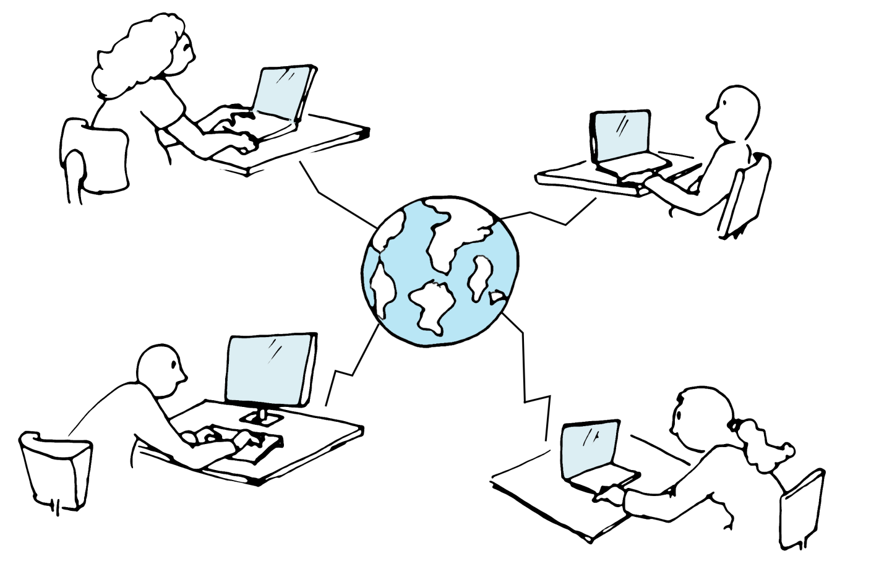
Experiences from two online courses at the University of Copenhagen before 2005
Tried to make dialog-based online learning but…:
Low activity
High drop-out rates
Response to my answers/ questions always come too late
What if somebody misunderstands me?
I feel lonely
I don’t have to do the work if I don’t want to
I don’t know how to do the techniccally
I prefer to be a ”lurker”
Notes:
Twelve years ago we had two courses in Tropical forestry which had been transformed into distance courses with little success. There were low activity and high drop-out rates.
->Some of the reasons we found were that the students felt isolated and ->there were technical barriers affecting the student. ->That is because they had to participate in a highly academic discussion in a system they were not familiar with.
->Some student didn’t feel obligated to participate and -> maybe some was thinking strategically “I don’t do any work if I don’t need to”
->And at last maybe the teachers were not good enough to give feedback and other student didn’t feel obligated to answer.

Slide 17
The teaching method
We needed to find a method that acknowledge and address:
The technical barriers in online learning
The barriers in online communication
Promote online group-work
The Five Stage Model by prof. Gilly Salmon,
… designed to promote online group-work and remove technical barriers
*Salmon, G. (2000 & 2004) E-moderating: The key to teaching and learning online, London: Taylor and Francis (www.e-moderating.com)
Notes:
So we needed a method that could help the students through the technical barriers and get them going in online discussions and collaboration.
We found that the five-stage model by Gilly Salmon would provide us with a method that could address these problems. So let’s have a look at this model.

Slide 18
The Five-Stage model
Notes:
So what is The five-stage model?

Slide 19
The Five-Stage Model*
A stepwise learning method…
Development
Focus on collaborative knowledge construction
Collaborative knowledge construction
Information sharing
Focus on building a social community
Online socialization
Access and motivation
*Salmon, G. (2000 & 2004) E-moderating: The key to teaching and learning online, London: Taylor and Francis (www.e-moderating.com)
Notes:
In the Gilly Salom model there are 5 stages of collaboration.
* In the first 3 stages the focus in on building an online social community and off course, getting over technical barriers.
* In the last 2 the focus is turned toward collaborative knowledge construction where the learning really takes place.

Slide 20
Building blocks – The Five-Stage Model
Primary tasks:
Prepare exercises
Facilitate the discussions/weaving
Provide new angels
Summarize
Two building blocks:
The specific defined role of the
teacher/e-moderator
The way the online exercises/e-tivities are designed
Will always contain:
Explicit objective, spark, task and deadline
Will always contain:
Explicit objective, task and deadline
Notes:
The method has 2 building blocks: One which defines the teachers role. It is to prepare and facilitate the discussions, giving new angels to the discussion and summarize and terminate the discussions which is also know as e-moderating. Therefore the teacher will act more as a moderator or facilitator than as a teacher
The discussion activities, e-tivities, has a recognizable structure with: Explicit objective, task and deadline and -> maybe also a spark or teaser to inspire the discussion.

Slide 21
The Five Stage Model – First stage
Step 1 exercise – Access and motivation
Objective: “The students access the LMS, find their course, and reply to a simple question”
Development
Task: “Post a reply to the welcome message from your e-moderator to say you are here, ready to start e-learning. Post your contribution before Tuesday 3 February”
Collaborative knowledge construction
Information sharing
Online socialization
Access and motivation
Teachers role – step 1:
“Welcoming and encouraging”
Notes:
Let’s have a look at the stages of the 5 step model:
The first step is in most cases a short one. The purpose is to make sure that the students can log in to the system make them familiar with the course design and reply in a discussion forum.
The teachers role as a moderator will be to welcome the students and encourage them to post replies. Latecomers might be contacted personally to ensure that they have no problems accessing the course etc.
->The task should be clear to the students as in all things in an online course, like what is expected from them and when is the deadline: Clarity is very important.

Slide 22
The Five Stage Model – Second stage
Step 2 exercise – Online socialization
Objective: “That the students establish their online identities and start interacting with each other”
Development
Task: Like you were on facebook start to create your profile:
Update your profile with a valid e-mail and a profile picture here
Post a few lines about who you are, your nationality, where you live, your educational background, your expectations for the course and something in your private life that you feel like sharing. It can be a little about your family, friends, hobbies, travels or whatever you like. Reply to at least three fellow group members with acknowledgements and positive remarks. Post your first contribution Tuesday 3 February.
Collaborative knowledge construction
Information sharing
Online socialization
Teachers role – step 2:
“Build bridges and familiarize”
Access and motivation
Notes:
The second step focus on the online socialization:
At this step you start to build an online community in which the participants get familiar with each other so they will fell safe and confident in participating in an online discussion.
As mentioned earlier it is for the most quite scary to put your thoughts in writing as it will stand there for a long time regardless of how clever it is. Therefore this is a very important part of the course.
-> The task should encourage them to get to know each other.

Slide 23
The Five Stage Model – Third stage
Step 3 exercise – Information exchange
Objective: “That the students can find relevant information and that they starts to share information with each other”
Task: Write a message where you provide the internet address of your forestry related website. Add a few lines were you explain why you have chosen it. Respond to another fellow group members post, for instance by visiting her favorite forestry site and commenting. Remember to be constructive.
Deadline: Friday 4 September 22:00 CET
Development
Collaborative knowledge construction
Information sharing
Teachers role – step 3:
“Facilitate task and support”
Online socialization
Access and motivation
Notes:
At the third level the students will start to exchange knowledge. The moderator will facilitate this discussion and will still have have to give support, like making rules for the discussion, as you will see here.
Here the students are asked to find relevant sites on the internet and share them. They have to respond to other students posting as well.
In this case the exchange can also encourage socialization.

Slide 24
The Five Stage Model – Fourth stage
Step 4 exercise – collaborative knowledge construction
Objective: “To create knowledge together in the groups and to share intellectual resources amongst the participants”
Task: Bruce (1999) links securing property under national law to the two concepts or main principles of “security” and “flexibility”. Provide a brief explanation how these two legislative principles might be conflictive with each other. Then discuss how security or flexibility promote or constrain local autonomy as well as the right of individuals in relation to the management of local common pool resources. Each participant must post at least one message and replay to at least one message by another participant. At the end of the discussion, a group member will summarize the discussion and post it in the “assembly hall”.
Deadline: Friday 11 December at 20:00 CET
Task: Bruce (1999) links securing property under national law to the two concepts or main principles of “security” and “flexibility”. Provide a brief explanation how these two legislative principles might be conflictive with each other. Then discuss how security or flexibility promote or constrain local autonomy as well as the right of individuals in relation to the management of local common pool resources. Each participant must post at least one message and replay to at least one message by another participant. At the end of the discussion, a group member will summarize the discussion and post it in the “assembly hall”.
Deadline: Friday 11 December at 20:00 CET
Task: Bruce (1999) links securing property under national law to the two concepts or main principles of “security” and “flexibility”. Provide a brief explanation how these two legislative principles might be conflictive with each other. Then discuss how security or flexibility promote or constrain local autonomy as well as the right of individuals in relation to the management of local common pool resources. Each participant must post at least one message and replay to at least one message by another participant. At the end of the discussion, a group member will summarize the discussion and post it in the “assembly hall”.
Deadline: Friday 11 December at 20:00 CET
Development
Collaborative knowledge construction
Teachers role – step 4:
“Facilitate learning process/discussions”
Information sharing
Online socialization
Access and motivation
Notes:
Now we have come level 4 and the collaborative knowledge construction. The objective is to CREATE knowledge. Here the teacher will properly not have to give support but will facilitate the discussion by participating and weaving the students postings together.
->As you can see we have reached a higher level of an academic discussion. Please notice that the teacher will have less moderation to do as one of the students are given the role of summarizing the discussion.
Finally the teacher are asking 2 things from the students. ->This second part the moderator could give later in the discussion which will make it easier to keep focus and actually so to say preventing the first responders to give an answer to everything from start and maybe give those who will log on later a chance to be the first to respond to the second task.

Slide 25
The Five Stage Model – Fifth stage
Step 5 exercise – Development of new knowledge
Objective: “Promotion of independent critical thinking and reflection”
Task: In small groups, describe what kind of decentralization (if any) is taking place in your country, and what outcomes this has produced. Consider what you think could be done in order to improve decentralization outcomes, or in case no decentralization is taking place, why this is so and whether decentralization should or should not be promoted. Motivate your opinion and try to identify similarities and differences between the countries represented in your group.
Each group will summaries their finding and post them in the “assembly” room.
Deadline: January 16 at 20:00 CET
Development
Teachers role – step 5:
“Support the learning process/discussions”
Collaborative knowledge construction
Information sharing
Online socialization
Access and motivation
Notes:
At stage 5 the students are really challenged in the development of new knowledge. The students should reach a high level of reflections and critical thinking.
Off course, all this is initiated by the task of the teacher and the moderation of the discussion.

Slide 26

Sum-up on the Five Stage Model
Stepwise learning model aiming at:
  Get rid of technical barriers
  Create a supporting and safe environment
  Make the students participate actively in the education
  Create knowledge in collaboration with each other
Each step have a specific pedagogical goal and a defined role for the teacher to promote activity and collaborative learning
The academic level of the exercises increases from step to step.
Notes:
To sum up: The model aims to
Get rid of technical barriers
Create a supporting and safe environment
Make the students participate actively in the education
Create knowledge in collaboration with each other
Each step have a specific pedagogical goal and a defined role for the teacher to promote activity and collaborative learning
The academic level of the exercises increases from step to step.

Slide 27
How did we do it?
Notes:
Now, how did we start?

Slide 28
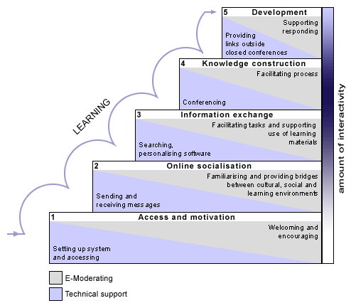
The time schedule
One 7,5 ECTS point course last 9 weeks
Exam week
Week 3 - 8
Week 1-2
Notes:
If we look at the time spent in the courses we worked with, a course that runs over 9 weeks, 8 week of teaching and one week for the exam. The first 2 weeks the focus is on building an online community while the last 6 weeks the focus is on the collaborative knowledge construction.

Slide 29
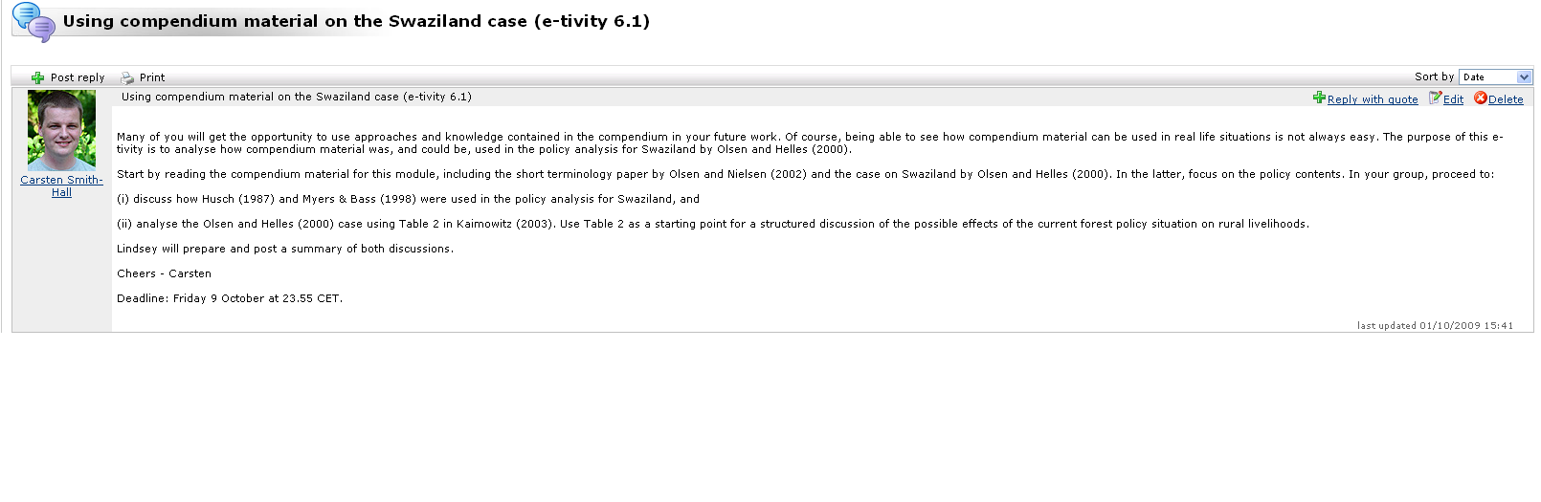
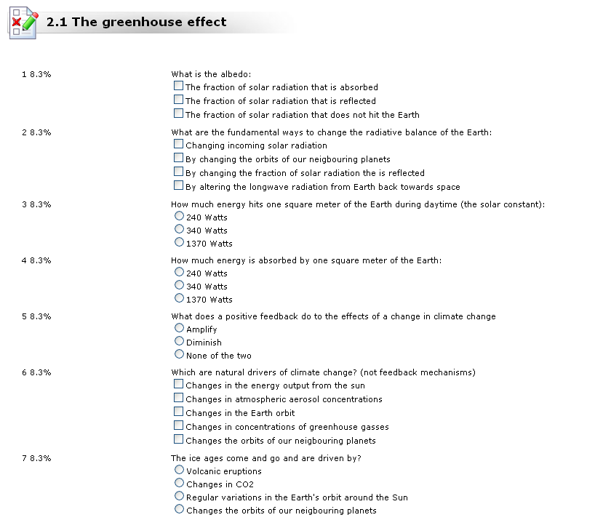
The workload
3 to 5 exercises in each module (each week)
Mix of exercises:
Discussion based exercises:
Deals with theoretical “dilemmas and problems”
Multiple choice: Relate to facts and theory
Notes:
A module ran for one week and contained 3-5 exercises, like discussions or tests but it could be written assignment etc.

Slide 30
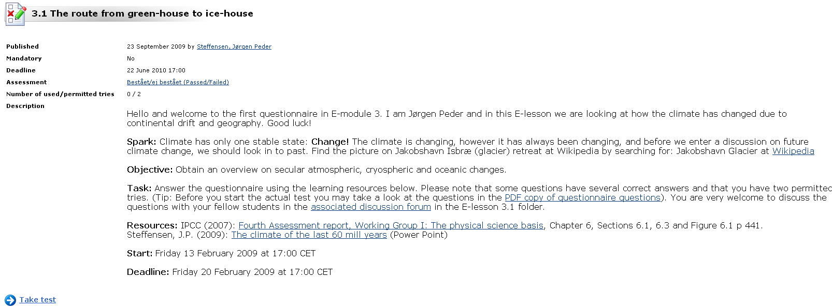
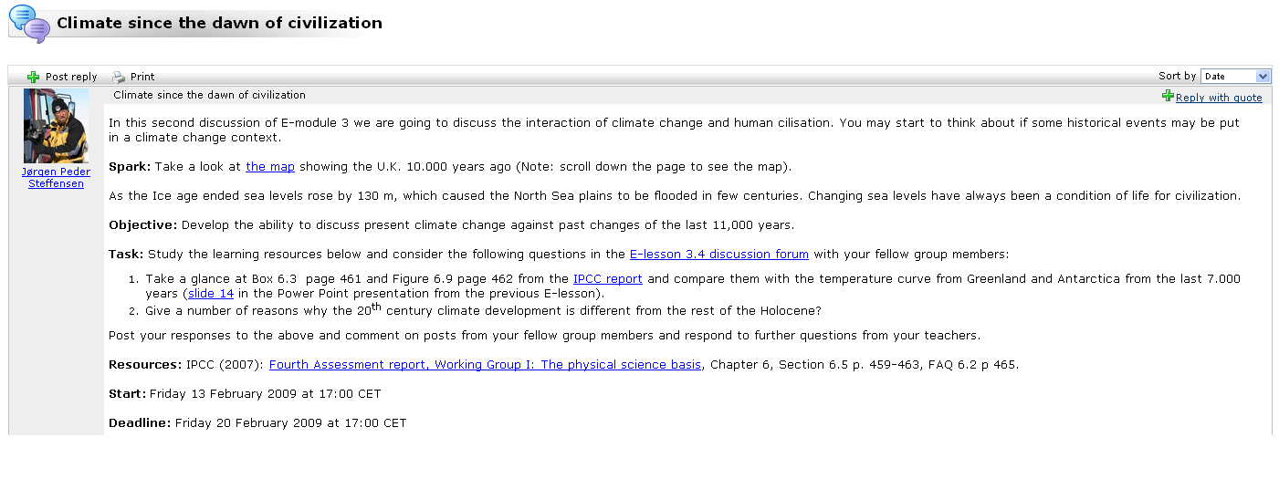
The course structure
Fixed structure in modules and exercises:
Welcome: Creates trust and motivation
Spark: Prompt associations
Objective: Creates overview of the learning outcome
Task: Eradicates confusion
Resources: Provides easy access and overview
Start & deadline: Encourage time-management
Notes:
The e-tivities were made with a recognisable structure
A welcome message to create trust and motivation
A spark to prompt associations or inspire the discussion
An objective to create an over what the learning outcome should be
The task in a clear language so misunderstanding will occur
Resources like reading material which is the foundation for the discussion
Start time and deadline to make the students time-conscious

Slide 31
An adaptation we made
It is mandatory to participate!
  Need to pass 75% of the modules (60 % of the exercises)
  A percentage of the final grade is based on the contributions
Guiding principles:
1. Ability to use introduced terminology, concepts, models and theories
2. Ability to critically analyze and discuss issues and problems
3. Logical and coherent analysis and presentation of arguments
4. The scientific contents and quality of postings
5. Ability to correctly interpret literature
6. Contributions should be properly organized (systematic and well-structured)
7. Language should be clear and concise
8. Correct use of references
9. Time available
Notes:
A thing that differs from the Gilly Salmon model in our long-term online course is that the students’ participation in the discussions are valued.
It is mandatory so there is no doubt about the importance of the exercises and you need to pass 75 % of the weekly modules.
In return for the students efforts about 40-50 % of the final grade is based on their posting in the discussions. The grade are given from these guiding principles:
Guiding principles:
1. Ability to use introduced terminology, concepts, models and theories
2. Ability to critically analyze and discuss issues and problems
3. Logical and coherent analysis and presentation of arguments
4. The scientific contents and quality of postings
5. Ability to correctly interpret literature
6. Contributions should be properly organized (systematic and well-structured)
7. Language should be clear and concise
8. Correct use of references
9. Time available

Slide 32
Sum-up
9 week course structure: 7- 8 weeks of “scientific teaching”
Mix of multiple-choice and discussion based exercises
Fixed structure in the modules and exercises
Mandatory to participate
The students contributions are valued and graded
Notes:
To sum-up
9 week course structure: 7- 8 weeks of “scientific teaching”
Mix of multiple-choice and discussion based exercises
Fixed structure in the modules and exercises
Mandatory to participate
The students contributions are valued and graded

Slide 33
Did it work?
Notes:
Now, how did it work?

Slide 34
Did it work?
High grades:
The collaborative learning process -> more perspectives -> more knowledge
Mandatory to participate -> high activity -> high level of reflection, throughout the course
Written communication -> takes/needs more cognitive resources compared to oral communication -> more reflection
High activity:
A safe and committed community -> the students want to participate and feel obligated to participate
The design of the exercise makes the students active (..respond to, .. discuss, ..answer, etc.)
The teacher role: He/she are visible and encourage and motivate the students
Fixed structures and careful explanations -> no confusion
Low drop-out:
Easy start -> removes barriers and resistance against e-learning
Fixed deadlines every week -> the students have to work constantly - no time for drop-out ☺
All students are “visible” and can be contacted and helped by the teachers
The community feeling provides the students with some kind of identity -> they want to be a part of the group and the course
Notes:
Actually it did work
High grades because:
The collaborative learning process gave more perspectives and more knowledge
Mandatory to participate, gave high activity and a high level of reflection, throughout the course
Written communication takes/needs more cognitive resources compared to oral communication and demands more reflection
High activity:
A safe and committed community was build so the students wanted to participate and felt obligated to participate
The design of the exercise makes the students active (..respond to, .. discuss, ..answer, etc.)
The teacher role: He/she was visible and did encourage and motivate the students
Fixed structures and careful explanations reduced the confusion
Low drop-out:
An easy start that removes barriers and resistance against e-learning
Fixed deadlines every week so the students had to work constantly - no time for drop-out
All students were “visible” and could be contacted and helped by the teachers
The community feeling provided the students with some kind of identity - so they wanted to be a part of the group and the course

Slide 35
Further modifications
Notes:
Through the years we have tried some more modifications to the model. I will give some examples here.

Slide 36
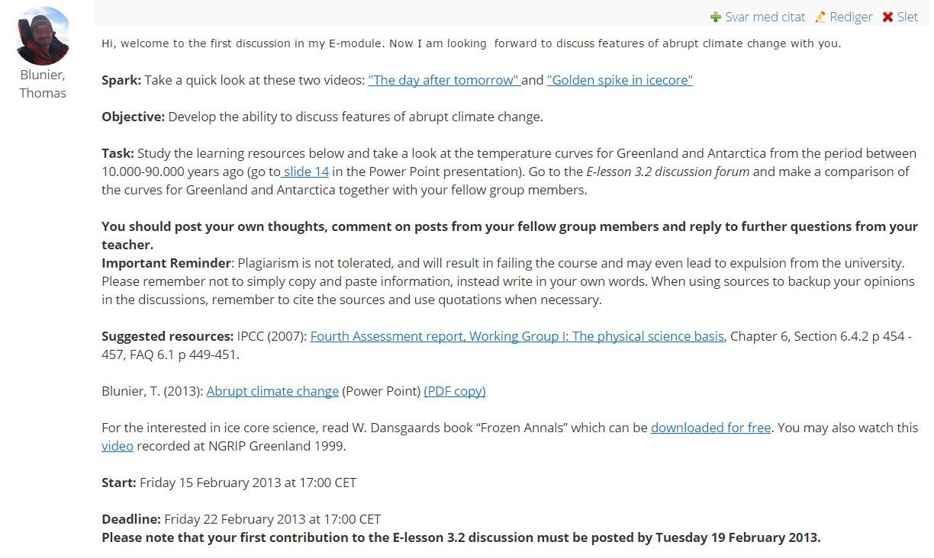
Plagiarism and late starters
Notes:
Using digital tools it is quite easy to copy/paste from online or digital resources into a discussion or an assignment.
It has become increasingly necessary to make it clear to the students what plagiarism is and to emphasize that it is cheating and that they can be kicked out of the course or the university, if they plagiarize.
Another problem we needed to handle was that when a discussion runs from one Friday to the next Friday, it is too late to go into the discussion the day before the deadline. So we had to add a deadline for the first posting as well.

Slide 37
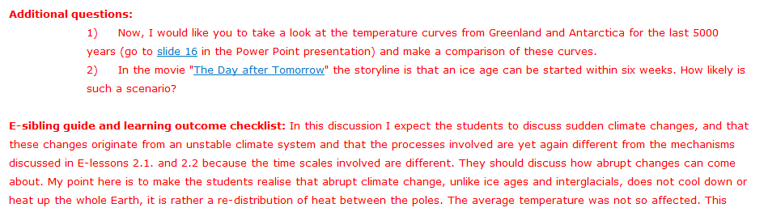
Additional questions and teachers guide
Notes:
As I mentioned earlier you can save some of the tasks to give new perspectives to the discussion. Here is the edition of the same e-tivity you saw before with instructions to the student assistants, here called e-siblings, containing additional questions and a guide to check the learning outcome. This makes much easier for the e-siblings to moderate the discussions.
And there is another story in using term e-siblings

Slide 38

Online community
Large online courses – up to 90 students
Divided into groups of max. 15 (recommended 8-12)
1 student assistant pr. group
Running 5 month
First two steps in two days: Internat and desktop video conference
Community:
E-godfather course responsible
E-professors the teachers
E-mom/E-dad daily coordinators
E-siblings/sisters/brothers student assistants
E-sisters/brothers the students
E-wizard problem solver
Notes:
In some of our larger courses with up to 90 students, they are divided into groups of 15 persons. We normally recommend 8-12 persons pr. group.
There one student assistant following each group to follow the group work from the start to the end of the course together with daily coordinator.
The first two steps of the five-stage model is done quiet quickly as most of the students are most students are gathered in Copenhagen for 2-3 days and the rest of the students are following the teaching and discussions live through desktop video conferencing.
And we do another thing to give to give the students a community feeling or family feeling. We all have names like one big family. The E-wizard that’s me.
Being one big family and having an intense start actually decreases the drop-out rate for the courses

Slide 39
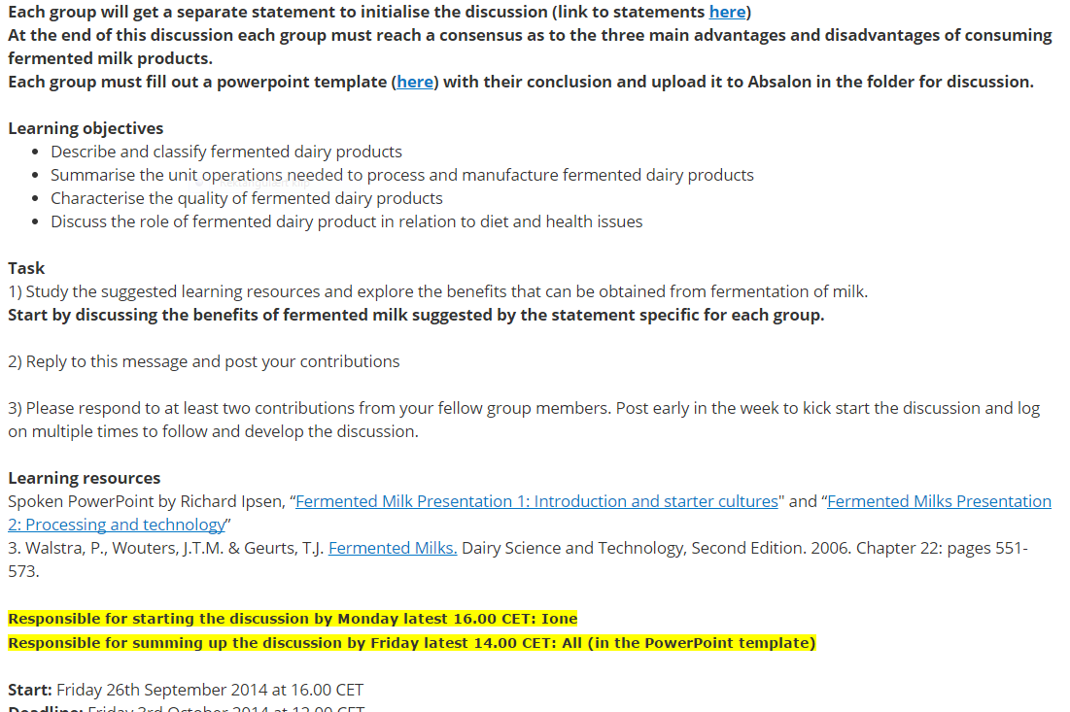
Variation
Notes:
We have found that it is important to make some variation during an online course, so it is not just discussions and quizzes.
Here the group work together to make a product in this case a PowerPoint presentation. This makes the discussions more concrete to make a product.
Another variation is to give the students different roles, like the role of starting a discussion, summing in the middle and summing up in the end of the discussion. This belongs to level 4 or 5 in the five-stage model.

Slide 40
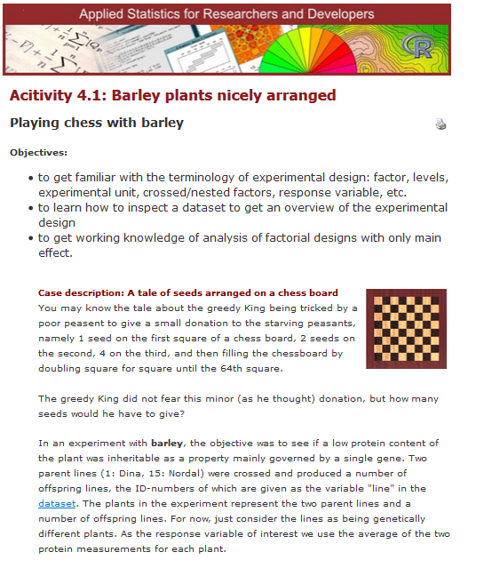
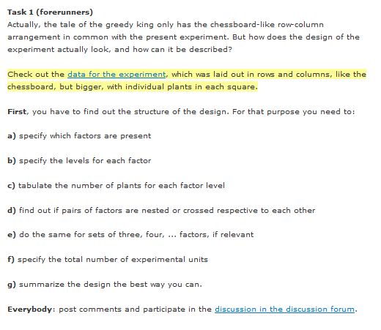
More roles
Notes:
Here we have actually made an online course in statistics.
At level 3-5 in the model two students have the role of being forrunners. They should solved a statistic problem and present their solution to the rest of the group in a discussion board. Then they had a debate in the group about methods, graphics and conclusions.

Slide 41
Sum-up
Be aware of plagiarism and make rules
Build an online community to decrease drop-out
Make variation in the outcome of the group work
At level 4-5 activate the students take more responsibility for the discussion
Notes:
To sum-up:
Be aware of plagiarism and make clear rules
Build an online community to decrease drop-out
Make variation in the outcome of the group work
At level 4-5 activate the students take more responsibility for the discussion

Slide 42

Questions?

Slide 43

Henrik Kaas
Mail: hka@science.ku.dk
IT Learning Center
The Faculty Library of Natural and Health Sciences
University of Copenhagen
http://itlc.science.ku.dk/english
Notes:
Thank you for listening

Slide 44
Does it work?
Results from the analysis conducted in 2009 – ordered by the Danish Ministry of Science, Technology and Innovation.
“Quality parameters”:
Average grade
Activity
Drop-out
Student satisfaction

Slide 45
Does it work?
Grades:
12: For an excellent performance displaying a high level of command of all aspects of the relevant material, with no or only a few minor weaknesses.
10: For a very good performance displaying a high level of command of most aspects of the relevant material, with only minor weaknesses.
7: For a good performance displaying good command of the relevant material but also some weaknesses.
4: For a fair performance displaying some command of the relevant material but also some major weaknesses.
02: For a performance meeting only the minimum requirements for acceptance.
00: For a performance which does not meet the minimum requirements for acceptance.
-3: For a performance which is unacceptable in all respects.
8,5
8,4
7,5
The average on the 7-step ECTS scale | 2005 | 2006 | 2007 | 2008 | 2009 | Average
Participatory Forest Management | - | 9,1 | 8,5 | 8,2 | 7,9 | 8,4
Applied Socio-Economics in Tropical Forestry | 6,1 | 6,6 | 9,3 | 6,1 | 9,6 | 7,5
Climate Change - Impacts Adaptation and Mitigation | - | - | - | 8,6 | 8,4 | 8,5

Slide 46
Does it work?
>2
Activity:
In average, each student contributed with more than two postings in every discussion exercise throughout the courses.
Drop-out / completion:
Satisfaction:
Completion (%) | 2005 | 2006 | 2007 | 2008 | 2009
Participatory Forest Management |  | 90% | 94% | 100%
Applied Socio-Economics in Tropical Forestry | 77% | 92% | 100% | 93% | 100%
Climate Change - Impacts Adaptation and Mitigation |  |  |  |  | 92%
82,5%
60%
81,4%

