Slide 1
Christian Lauersen
Mail: cula@roskilde.dk
Twitter: @clauersen
EVENTOS
2019
XVII Jornadas CRAI
Digital Social Science Lab:
Connceting acadmia with data literacy

Slide 2
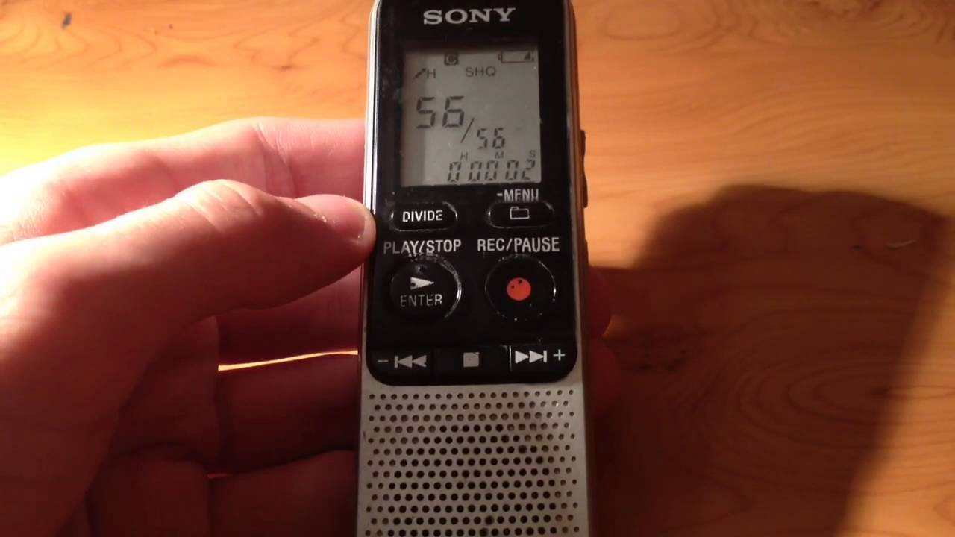
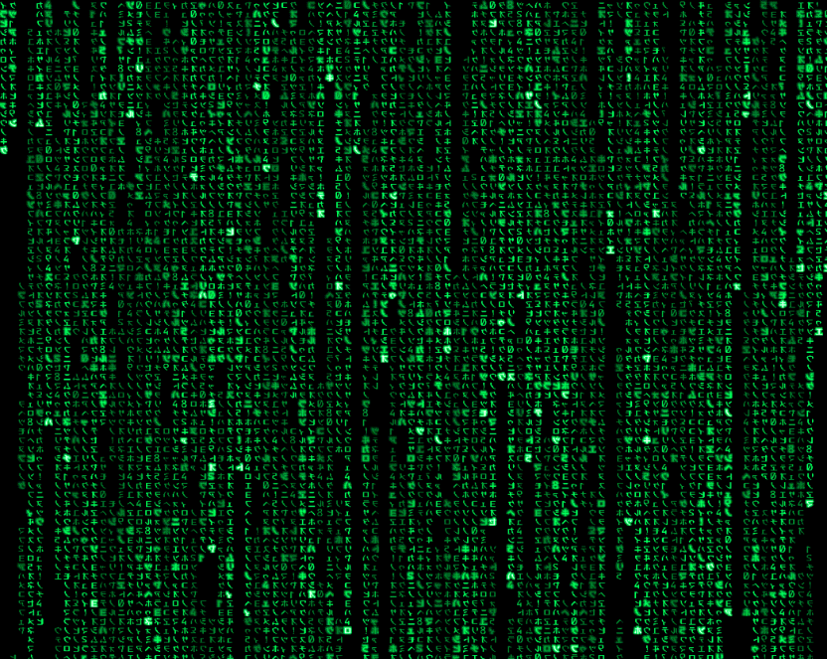
The story about 10 years and two different master thesis’

Slide 3
From 6 interviews and
35 pages of transcription to
the harvesting of 2.4 million
online articles in just 10 years

Slide 4
The library of today
might not fit
the reality of tomorrow

Slide 5
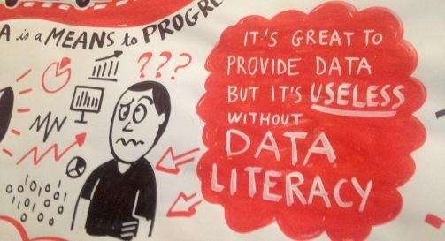
Change of habits among scholars and students

Slide 6
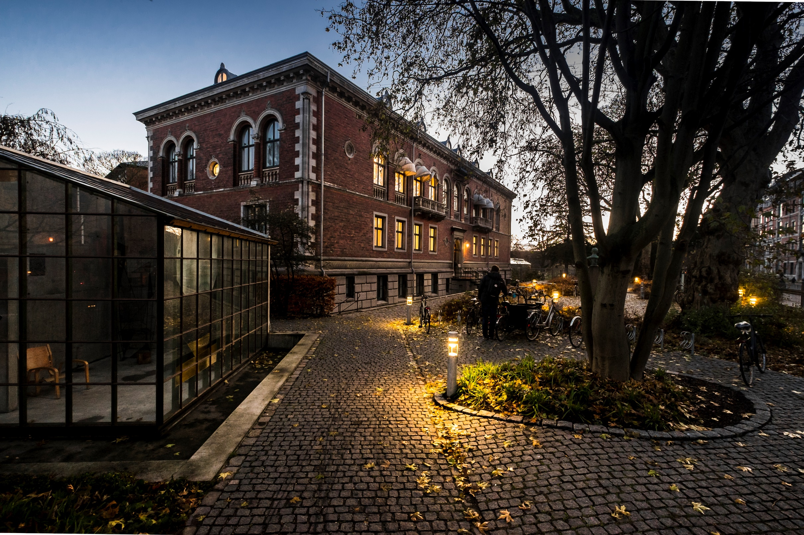
Context: Faculty Library of Social Sciences
Highly digital collection, no books in physical library

Slide 7
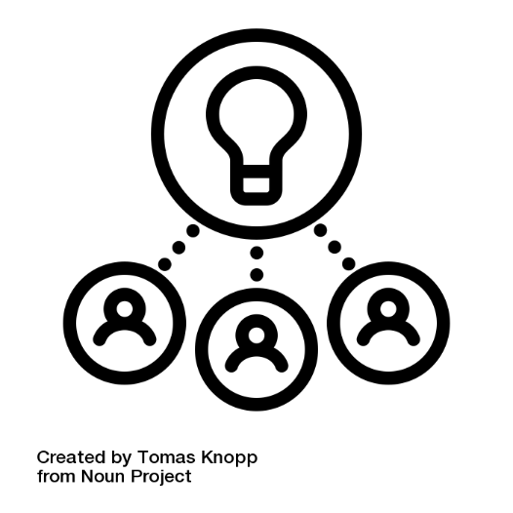

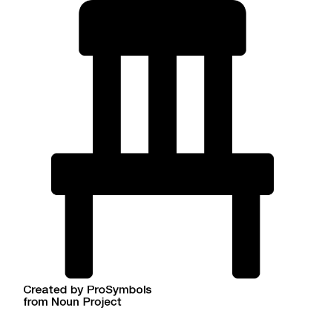
The (Academic) Library as place

Slide 8
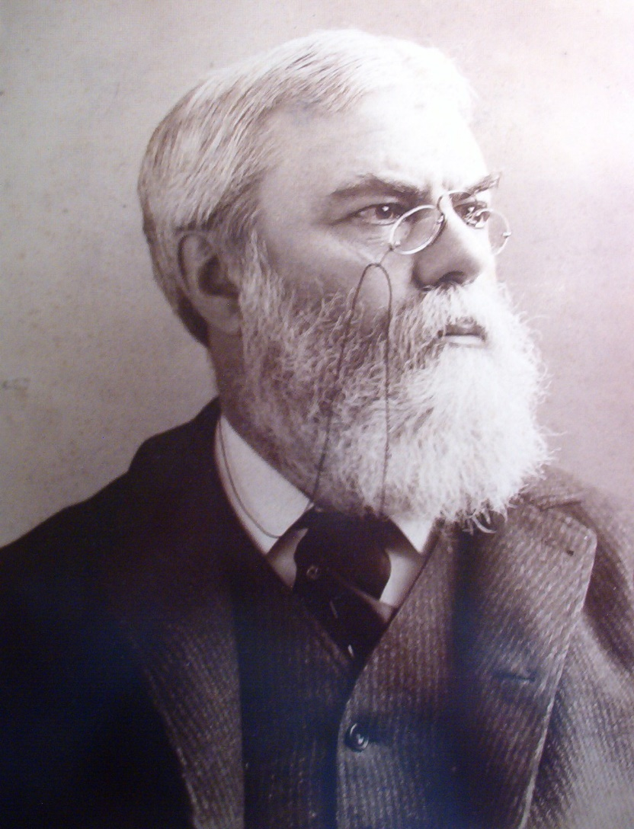
”A great library should be a
workshop as well as a repository.
It should teach the methods of
thorough research, and cultivate
in readers the habit of
seeking the original sources
of learning”
- Justin Winsor, late 1800

Slide 9
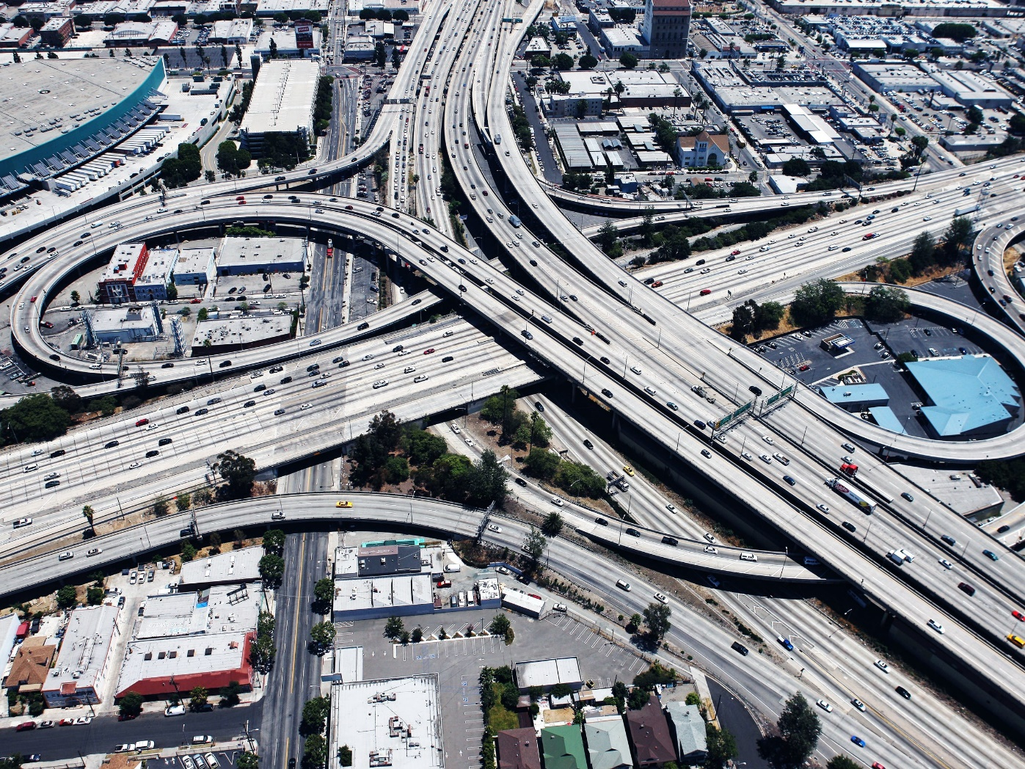
Something was missing:
Infrastructure

Slide 10
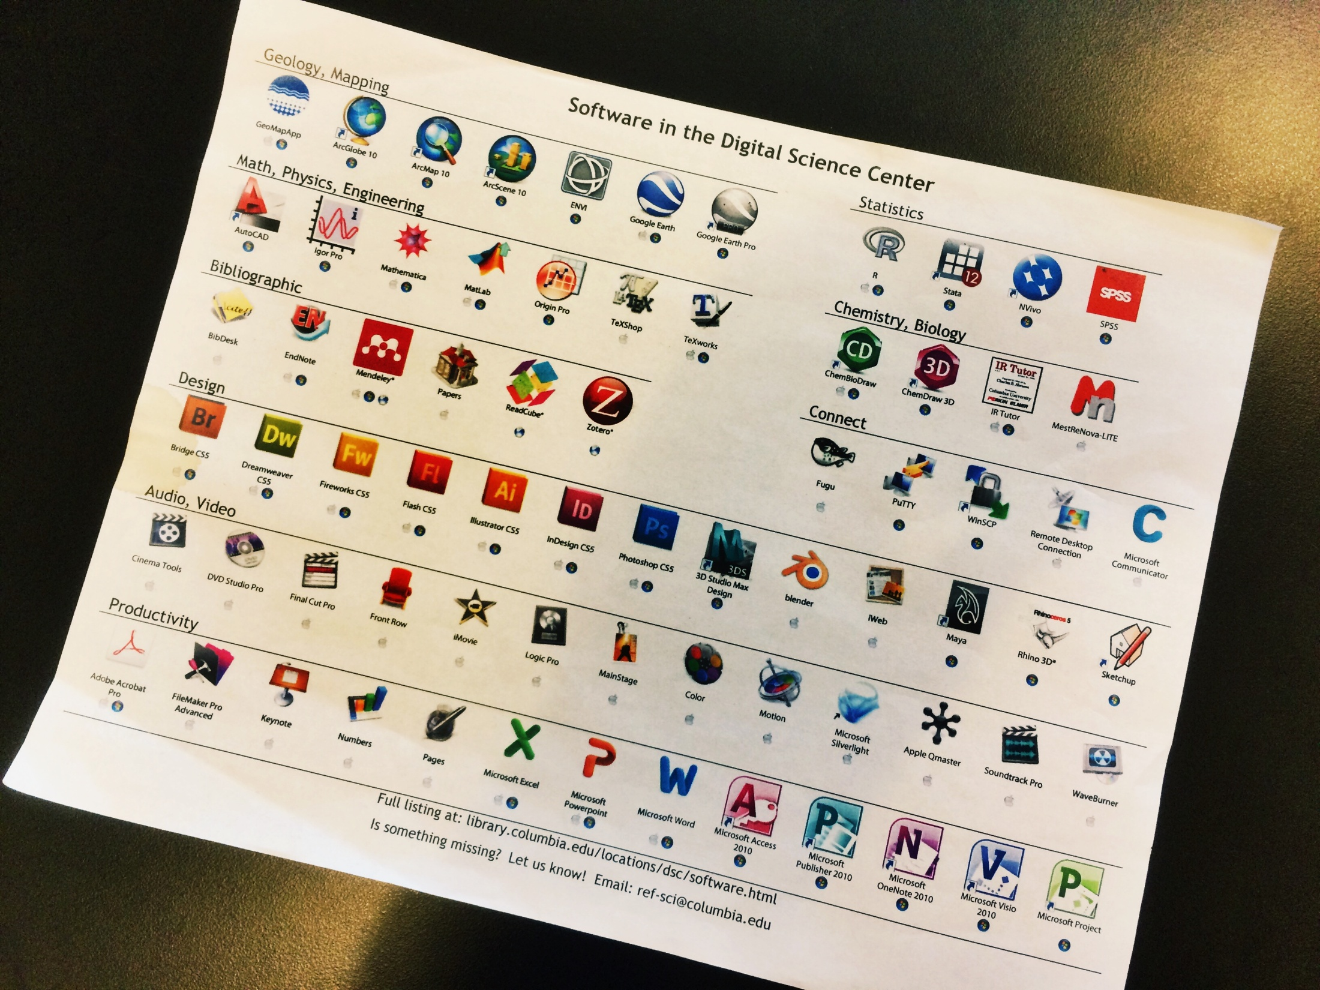
Inspiration

Slide 11
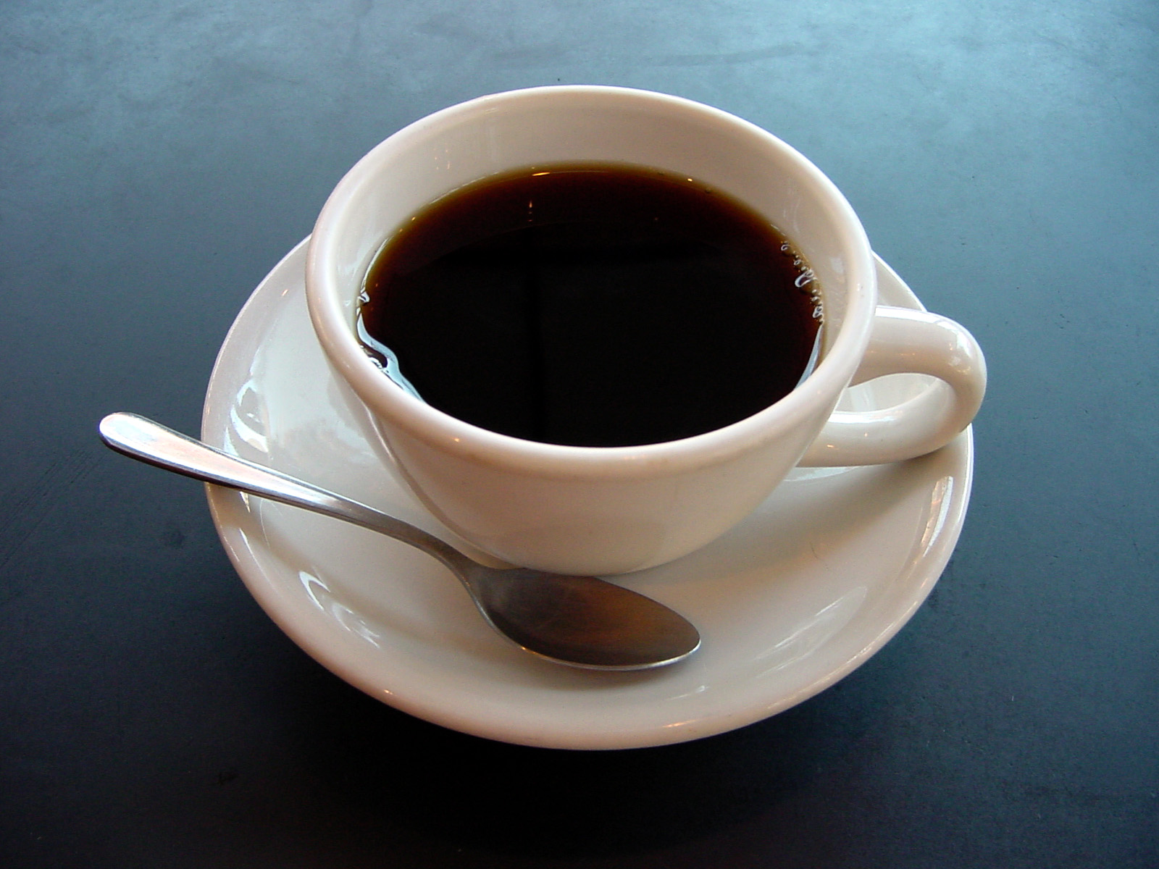
Hvad er Digital Social Science Lab?
Et fysisk rum til understøttelse af forskning, uddannelse og læring
Relevant software og hardware + vejledning og support
En platform for digitale metoder og værktøjer indenfor samfundsvidenskaben
Local knowledge and ownership

Slide 12
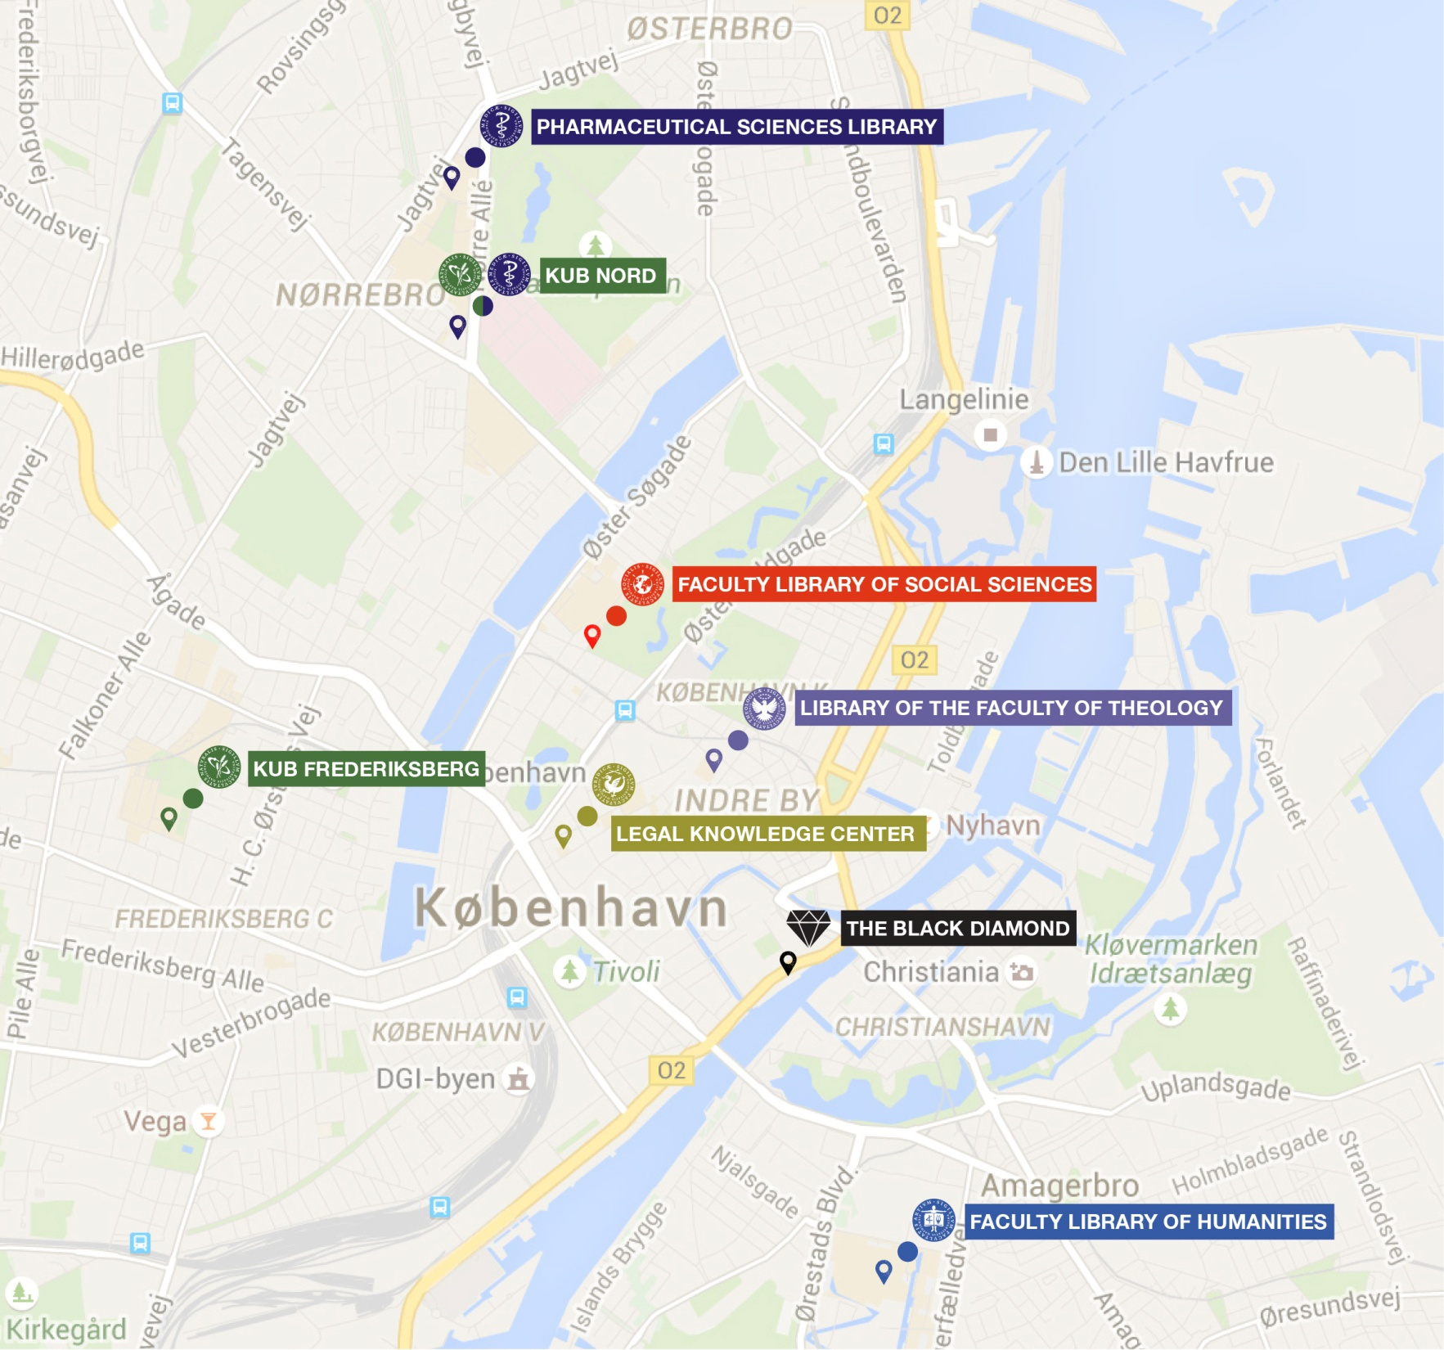
Kub kort
Hvorfor?

Slide 13


An open platform for education and events on digital methods
Hardware and software for harvesting, cleaning,
analyzing and visualizing data
A dynamic and aesthetically inspiring learning environment

Slide 14
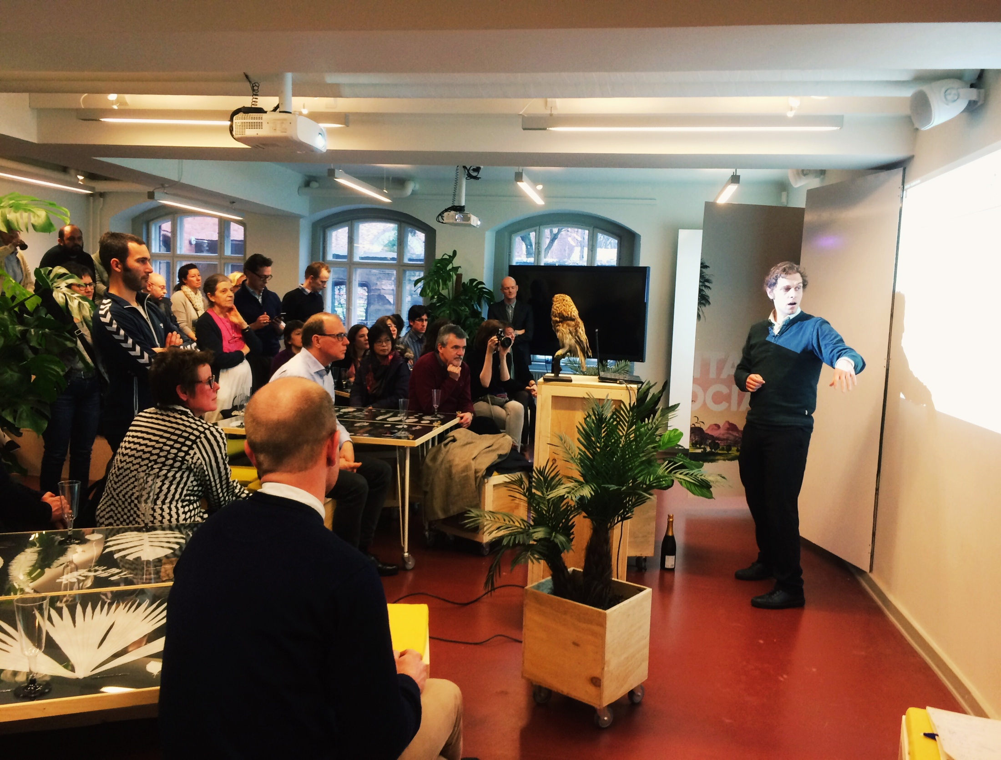
What we do
Events and teaching
Facilitating and curatering
Community building

Slide 15
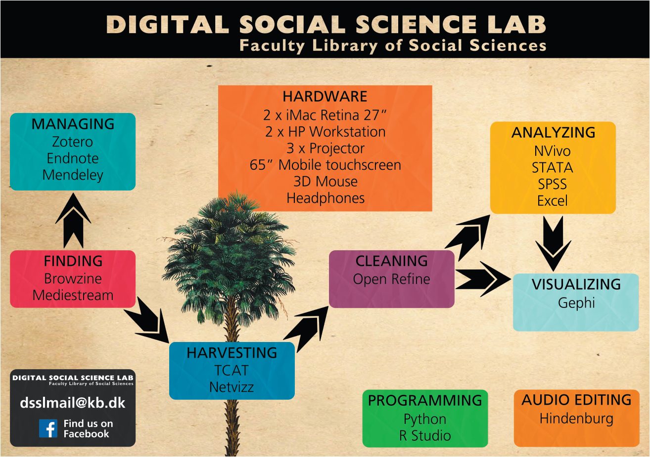

Slide 16
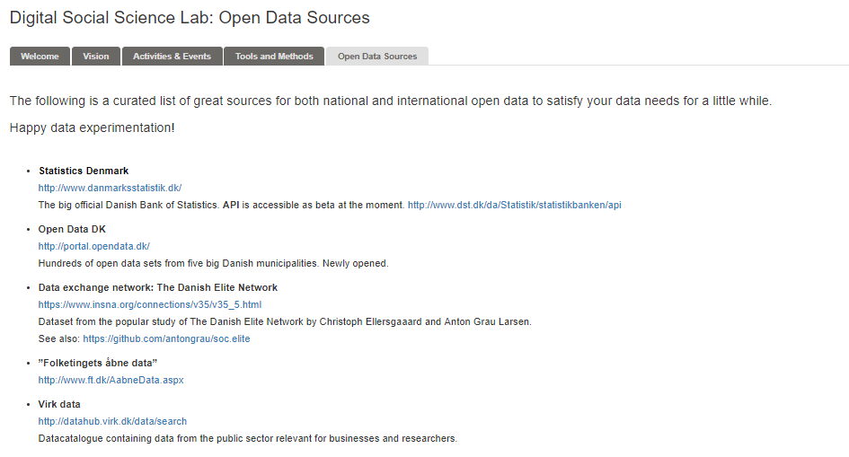
Curating open data sources

Slide 17
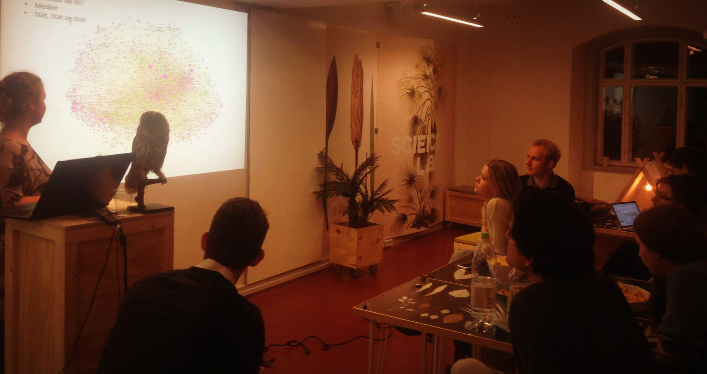
The library as hub:
Community and peer-to-peer

Slide 18
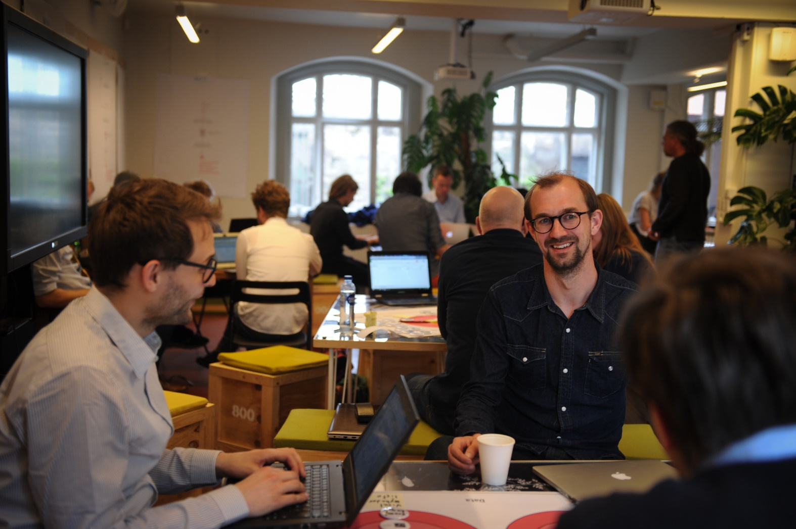
Digital methods sessions and data sprints

Slide 19
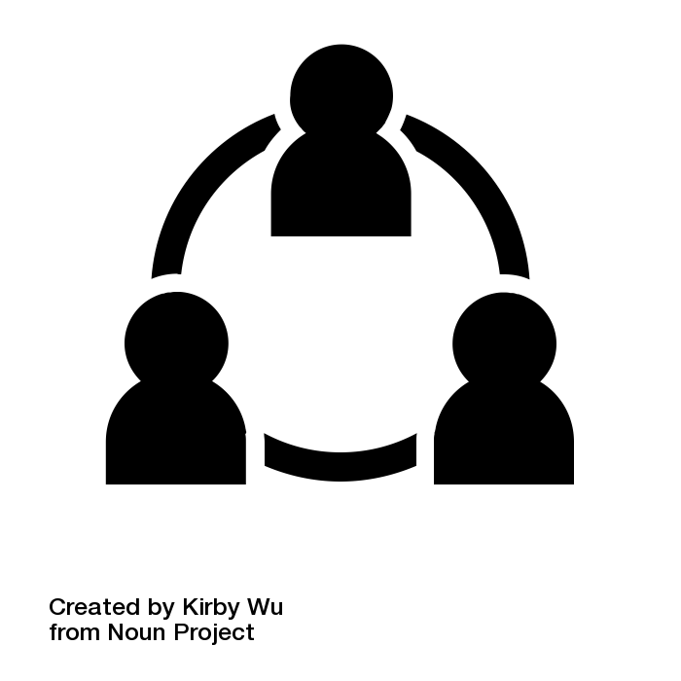
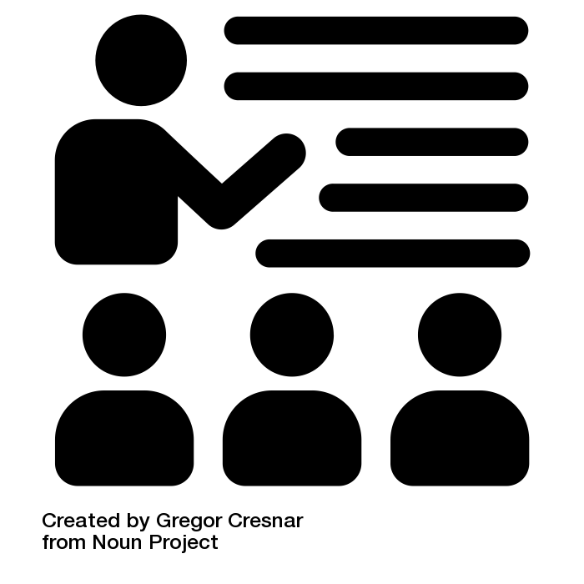
Traditional learning vs. peer-to-peer learning

Slide 20
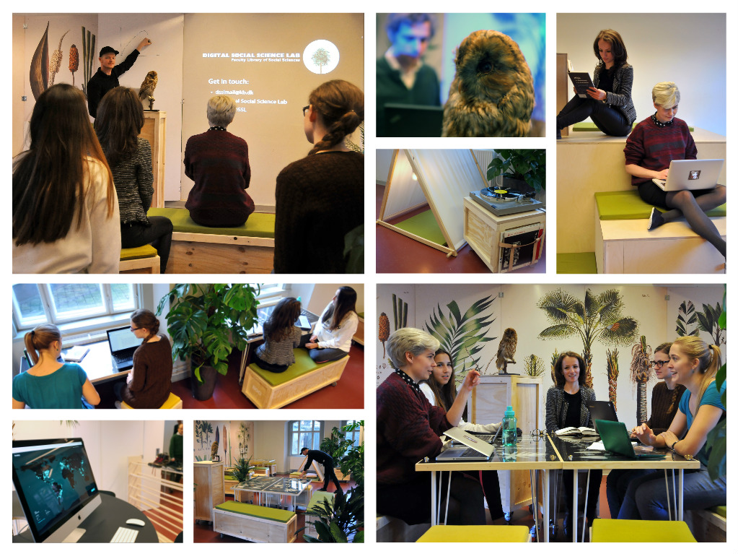
The space:
Flexible
Functional
Inspirational

Slide 21
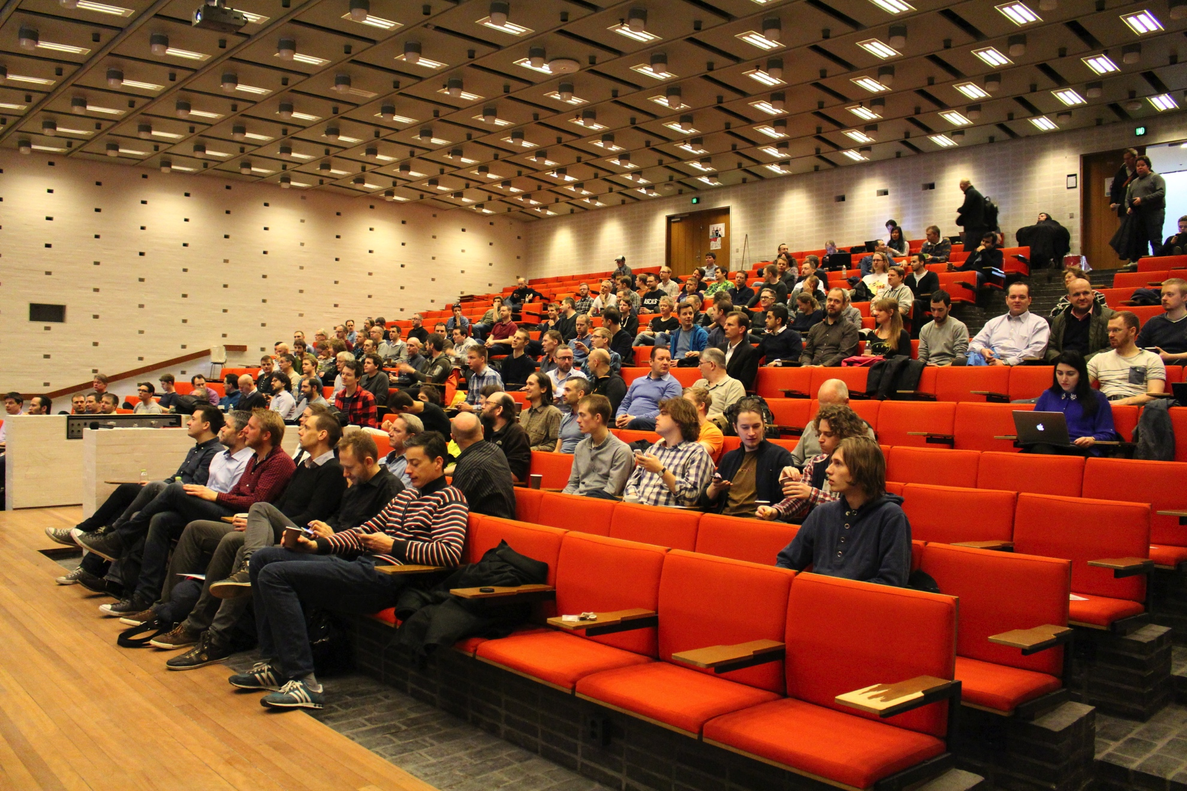
AN ALTERNATIVE TO THE TRADITIONAL LEARNING ENVIRONMENT
An alternative to the classic
learning environtment

Slide 22
The Evolving DSSL Network
Faculty
Aalborg University
Students
ETHOS Lab
Faculty members
Tearching and learning unit
DSSL
DTU
Etnographic Exploratorium
BADASS
Higher education
Libraries and archives
Danish Business Authority
Society
Open Data Network

Slide 23
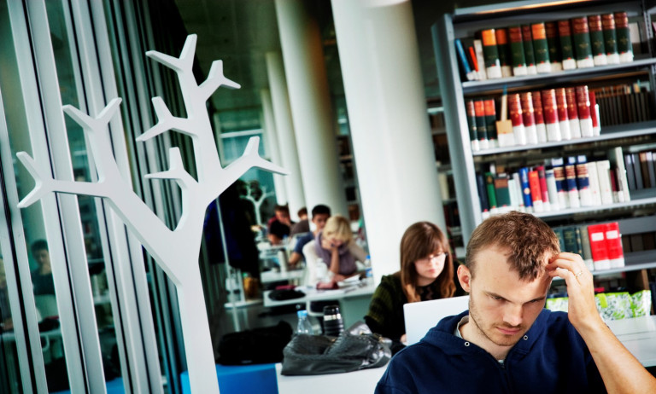
Side effect: The library as social infrastructure
Not only shared resources, also shared places
Belonging and interdiciplinary connections

Slide 24
Challenges in the proces
”Is this a library task?”
”On the expense of what?”
How do we get the relevant skills?
How do we talk about this project?
How do we position ourself towards the local research and educational environtment?

Slide 25
What we’re learned
It’s not enough to provide access to software and hardware
Skill development is a long proces and has to be in context of need and resources
The facilitating role is a good way to create value
Network is key
The Library is a very strong platform for bringing people together within academia
Library support of data literacy might not fit to all subjects

Slide 26
Final notes!
[how much time do I have left?]

Slide 27
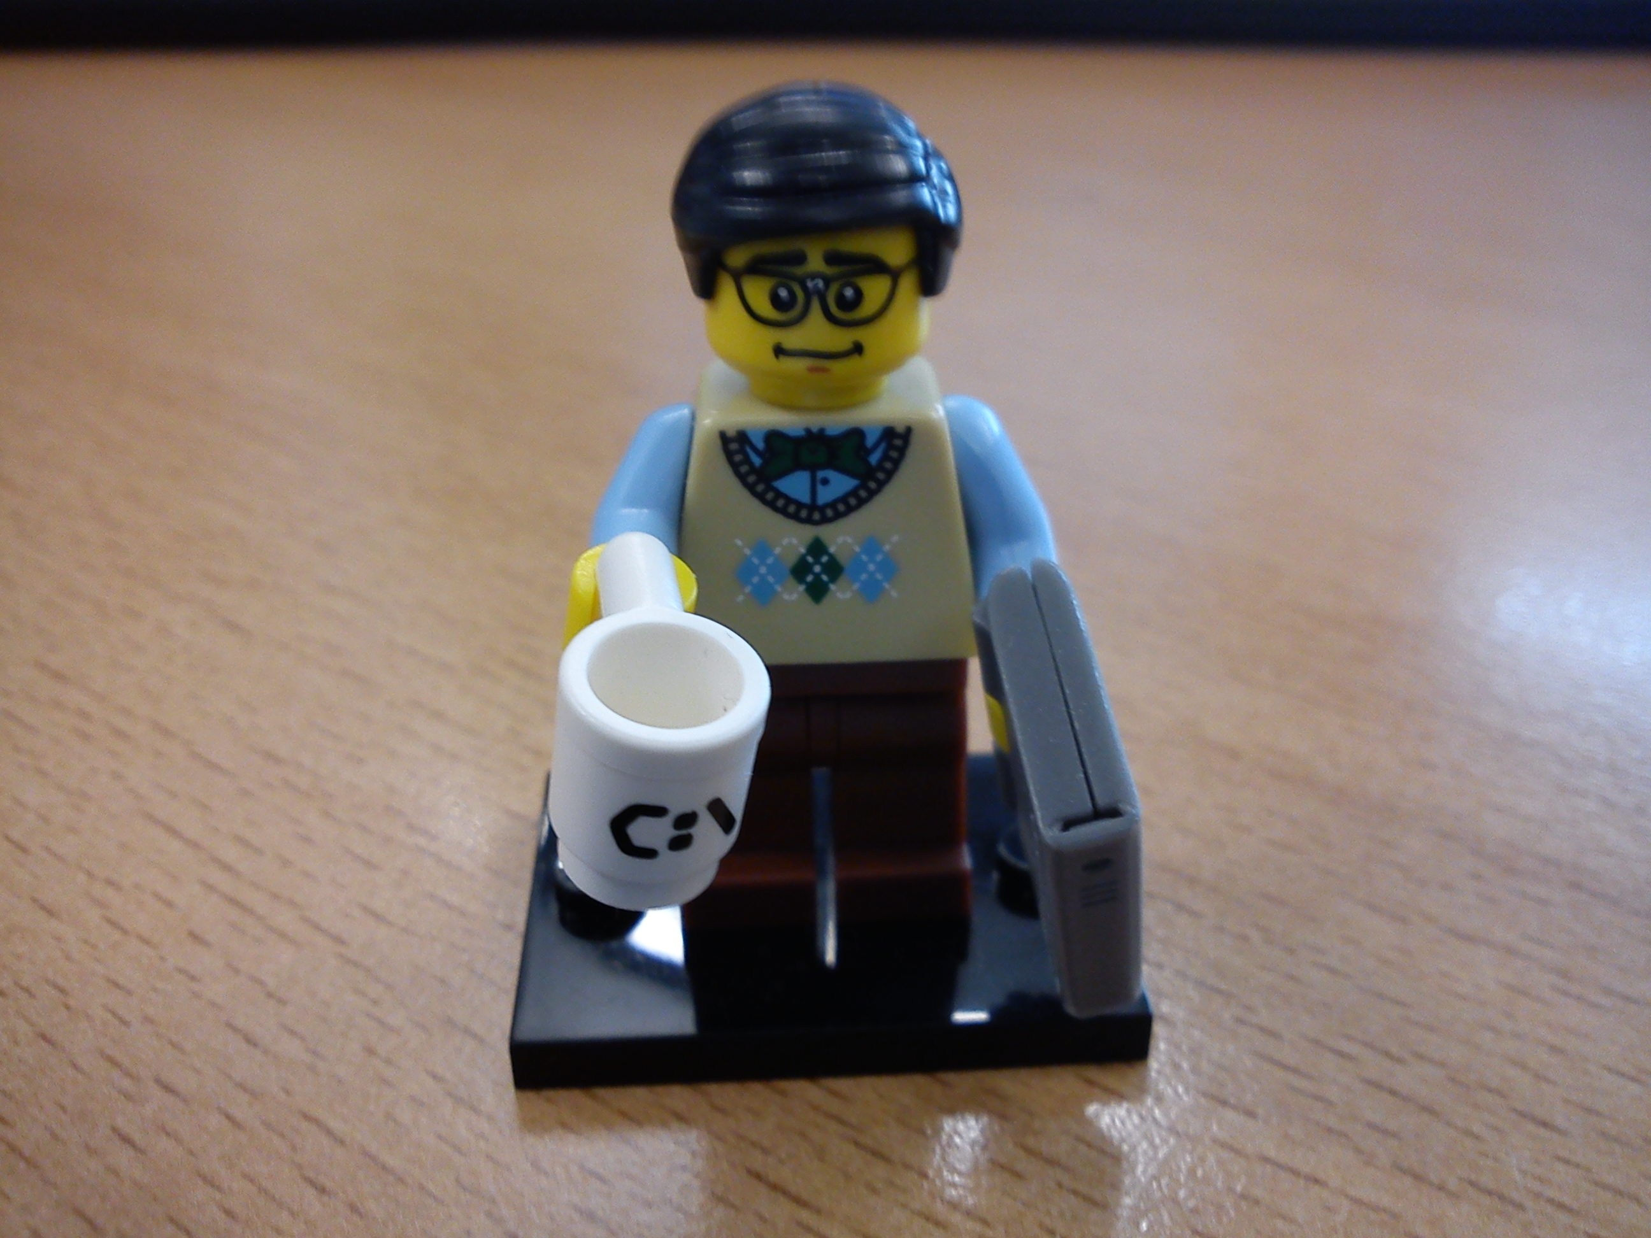
The librarian
Final notes #1: The most valuable asset of a library
is the employess and the community

Slide 28
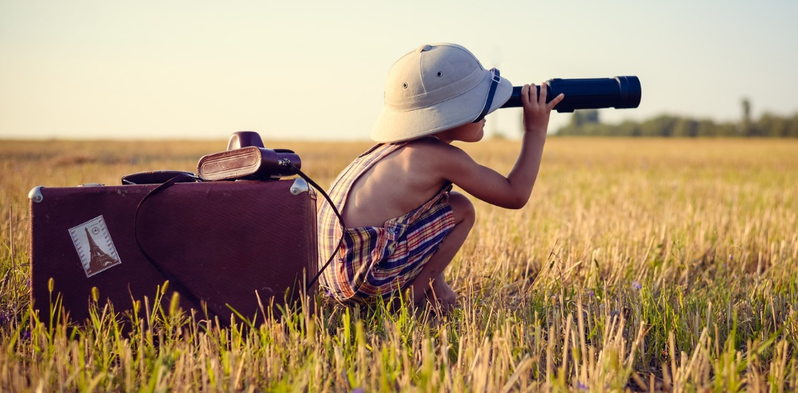
Final notes #2: Be like the anthropologist

Slide 29
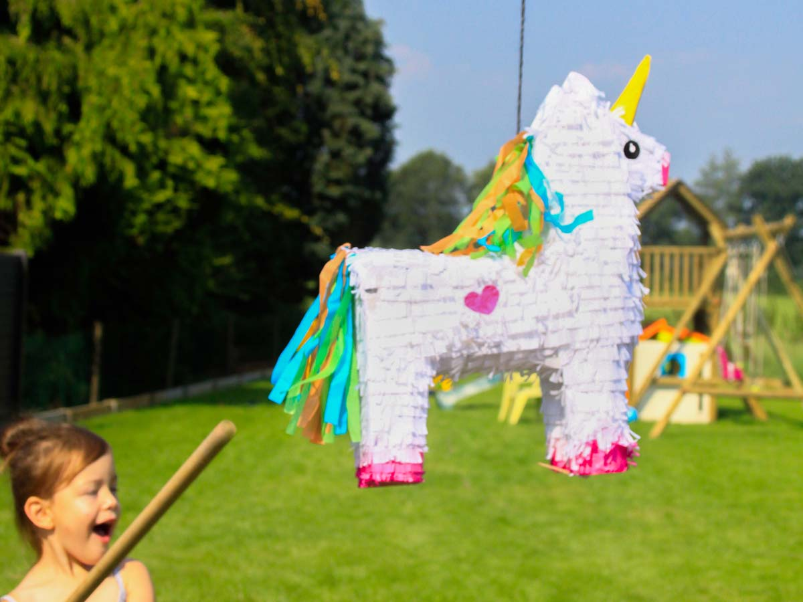
Final notes #3: Great data service is
a pinata of inter-related factors

Slide 30

Final notes #4: Functionality, functionality, functionality

Slide 31
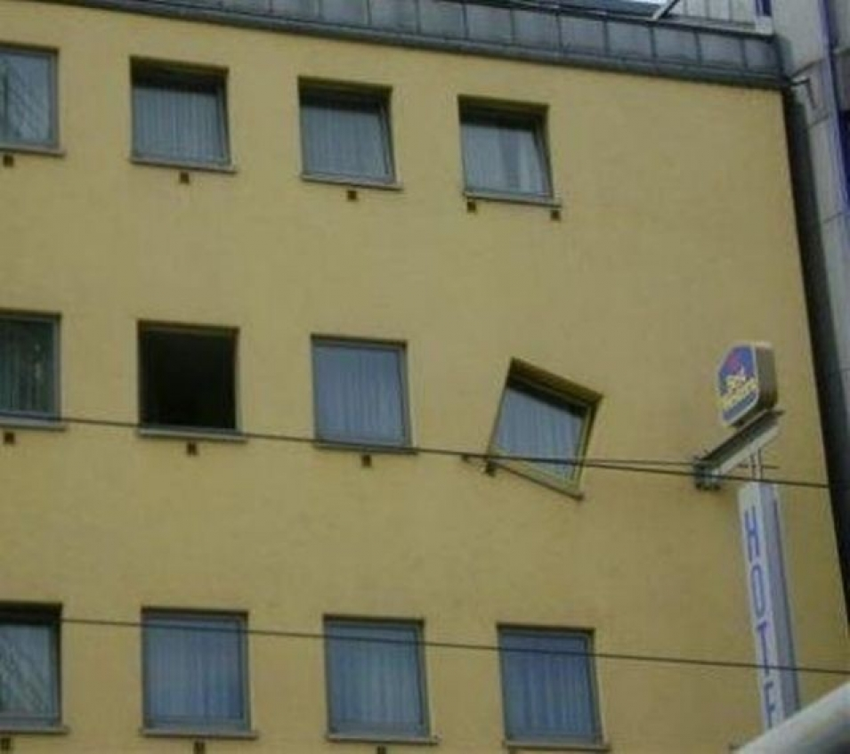
Final notes #5: Embrace failures

Slide 32
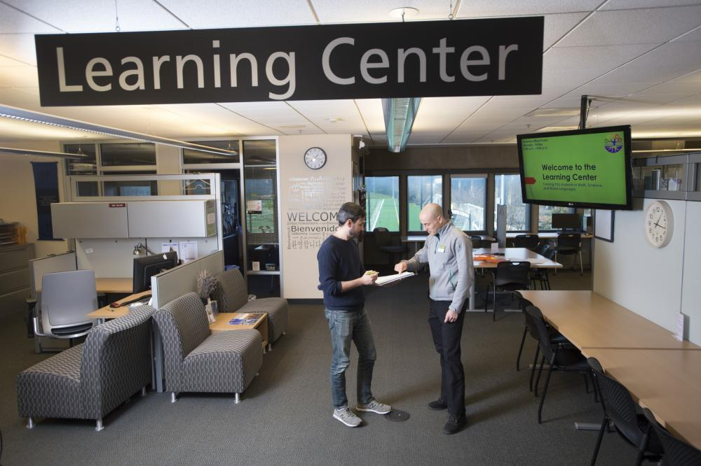
Final notes #6: Never ever change
the library name to something else

Slide 33
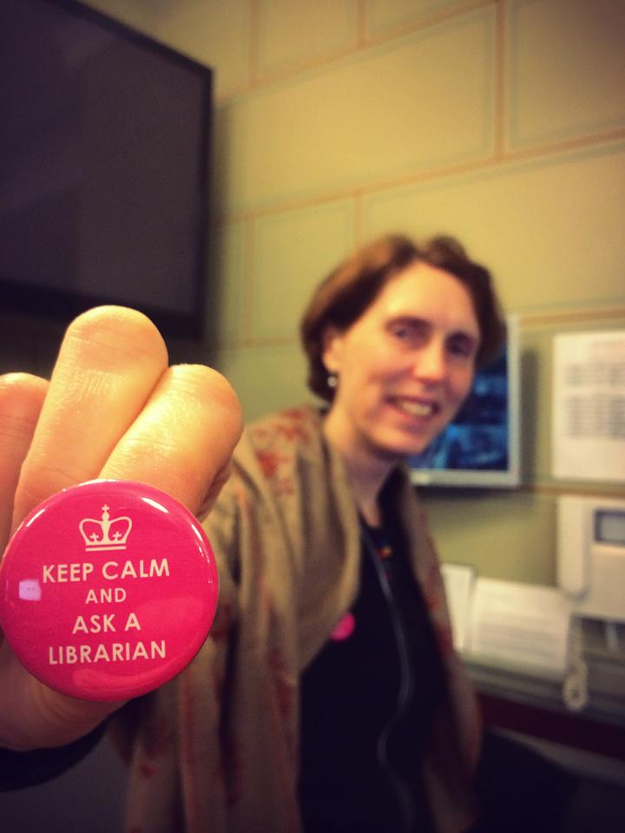
Final notes #7: Be proud

Slide 34
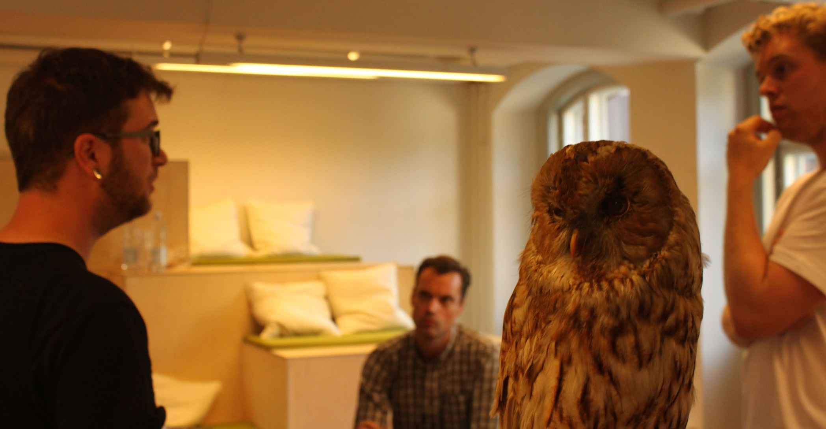
Gracias por escuchar!
Christian Lauersen
Director of Libraries and Citizen Services
Roskilde Municipality
Mail: cula@roskilde.dk
Twitter: @clauersen
The Library Lab: christianlauersen.net
Library Planet: libraryplanet.net
Instagram: @librarylovestories
Digital Social Science Lab
http://kub.kb.dk/DSSL

